Slide 1
Switching from a 3-Drug Tenofovir Alafenamide (TAF)-based Regimen to a 2-Drug Dolutegravir/ Lamivudine (2DR, DTG/3TC) Was Not Associated with a Higher Frequency of Intermittent Viremia in Suppressed Patients in the TANGO Study
Ruolan Wang,¹ Joe Horton,² Jonathan Wright,³ Rifaz Razeek,³ Mounir Ait-Khaled,⁴ Maria Claudia Nascimento,⁴ Allan R. Tenorio,¹ Mark Underwood¹
¹ViiV Healthcare, Research Triangle Park, NC, USA; ²Paraxel International, Durham, NC, USA; ³GlaxoSmithKline, Stockley Park, UK; ⁴ViiV Healthcare, Brentford, UK
Adverse Event and Prescribing Information can be found at the end of the presentation
Date of preparation: November 2019
PM-GB-DLM-PPT-190018

Slide 2
Introduction
TANGO is a 200-week, phase III, randomized, open-label trial to evaluate efficacy and safety of switching from a 3- or 4-drug TAF-based regimen to the 2DR DOVATO▼ (DTG/3TC) in HIV-1–infected adults with HIV-1 RNA <50 c/mL and without prior virologic failure or historical NRTI or INSTI major resistance mutations at study entry¹
Switching to DTG/3TC was non-inferior to continuing a TAF-based regimen through Week 48 using a 4% non-inferiority margin for Snapshot virologic failure (HIV-1 RNA ≥50 c/mL)¹
We assessed elevated viral loads (VLs) through 48 weeks of therapy overall by study visit
1. van Wyk et al. IAS 2019; Mexico City, Mexico. Slides WEAB0403LB.
Adapted from Wang et al. EACS 2019; Basel, Switzerland. Poster PE3/15.

Slide 3
TANGO Study Design
Screening
Randomizationª 1:1
Early-switch phase
Late-switch phase
Continuation
phase
Adults, virologically suppressed (HIV-1 RNA <50 c/mL) for >6 months
Stable TAF-based regimen
DTG/3TC (N=369)^{b}
DTG/3TC
TAF-based regimens (N=372)
DTG/3TC
DTG/3TC
Day 1
Week 24
Week 48
Week 96
Week 144
Week 148
Week 196
Primary endpoint^{c}: participants with virologic failure per FDA Snapshot (ITT-E)^{d}
ªStratified by baseline third agent class (PI, INSTI, or NNRTI). ^{b}2 participants excluded who were randomized but not exposed to study drug. ^{c}4% non-inferiority margin. ^{d}Includes participants who changed a background therapy component or discontinued study treatment for lack of efficacy before Week 48, or who had HIV-1 RNA ≥50 c/mL in the 48-week window.
Adapted from Wang et al. EACS 2019; Basel, Switzerland. Poster PE3/15.

Slide 4
Methods
Elevated viral loads (EVLs, HIV-1 RNA ≥50 c/mL) for exposed participants (intention-to-treat–exposed [ITT-E population]) with at least one post-baseline, on-treatment plasma HIV-1 RNA were assessed in 2 major categories: (1) with only VL ≥50 to <200 c/mL, or (2) at least one VL ≥200 c/mL
Each of these major categories was further divided into a single non-consecutive occurrence or >2 consecutive occurrence sub-categories
A “blip” is defined here as a VL of 50 to <200 c/mL with adjacent values <50 c/mL
Confirmed virologic withdrawal (CVW) criteria were defined as 2 consecutive on-treatment VL ≥50 c/mL with the second VL ≥200 c/mL
Adapted from Wang et al. EACS 2019; Basel, Switzerland. Poster PE3/15.

Slide 5
Results
The proportion of participants with EVLs through 48 weeks of treatment was low and comparable across groups
Most frequently observed VL rebounds were in Category 1a
By Week 48, no participant in the DTG/3TC group met CVW criteria
One participant on a TAF-based regimen without any pre-existing resistance met CVW criteria
No blips occurred before CVW and no emergent resistance was observed at failure
Adapted from Wang et al. EACS 2019; Basel, Switzerland. Poster PE3/15.

Slide 6
Summary of Participants With Elevated Viral Load Categories Through Week 48
Elevated VL categories for participants in the ITT-E population | DTG/3TC FDC (N=369) n (%) | TAF-based regimens (N=372) n (%)
1. Participants with VLs between 50 to <200 c/mL and no VL ≥200 c/mL | 11 (3%) | 22 (6%)
1a. VLs between 50 to <200 c/mL with adjacent values <50 c/mL (“blips”) | 9 (2%) | 18 (5%)
1b. ≥2 consecutive VLs between 50 to <200 c/mL | 2 (<1%) | 4 (1%)
2. Participants with at least one VL ≥200 c/mL | 3 (<1%) | 3 (<1%)
2a. A single VL ≥200 c/mL and no 2 consecutive VL ≥50 c/mL | 3 (<1%) | 1 (<1%)
2b. ≥2 consecutive VLs ≥50 c/mL with at least one VL ≥200 c/mL | 0 | 2ª (<1%)
Total (all categories) | 14 (4%) | 25 (7%)
ªOne participant met CVW criteria by Week 48.
Adapted from Wang et al. EACS 2019; Basel, Switzerland. Poster PE3/15.

Slide 7
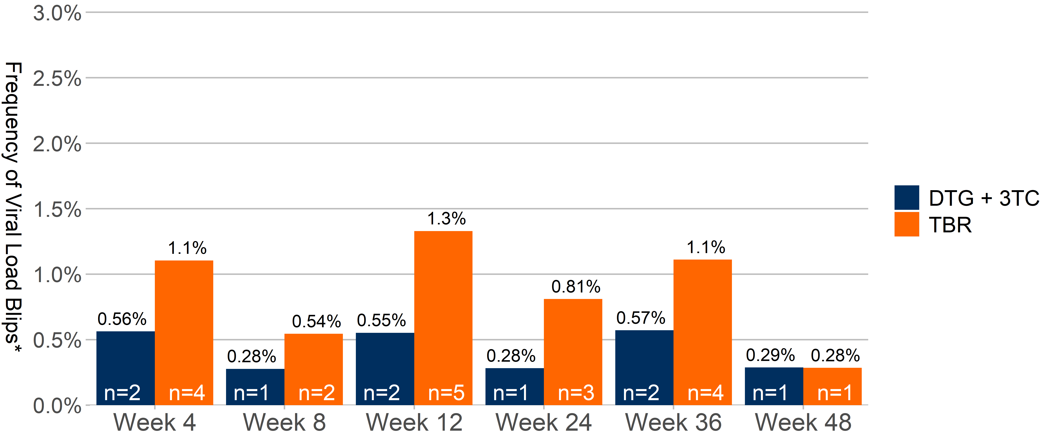
Frequency of Viral Load Blips in Category 1a Participants by Visit Through Week 48
DTG/3TC
The occurrences of viral blips at each visit by treatment group over 48 weeks were similar
*Percentages were calculated from number of blips in Category 1a participants using post-baseline previously suppressed (<50 c/mL) pt visit Ns respectively for DTG/3TC and DTG + TDF/FTC at: Wk 4 (N=355) and (N=362); Wk 8 (N=361) and (N=367); Wk 12 (N=362) and (N=376); Wk 24 (N=355) and (N=370); Wk 36 (N=350) and (N=360); Wk 48 (N=348) and (N=351). Numbers on the bottom of each bar represent # of blips at given week visit. Individual participants can have had more than one blip.
Adapted from Wang et al. EACS 2019; Basel, Switzerland. Poster PE3/15.

Slide 8
Conclusions
The occurrences of blips by visit were similar across treatment groups
All other categories of VL ≥50 c/mL occurred infrequently in all groups, and the occurrences were similar
Switching from a 3- or 4-drug TAF-based regimen to the 2DR DTG/3TC was not associated with a higher frequency of intermittent viremia
Adapted from Wang et al. EACS 2019; Basel, Switzerland. Poster PE3/15.

Slide 9
Prescribing Information Dovato ▼ dolutegravir 50mg/lamivudine 300mg tablets See Summary of Product Characteristics (SmPC) before prescribing
Indication: HIV-1 in adults & adolescents above 12 years of age weighing >40kg, with no known or suspected resistance to the integrase inhibitor class, or lamivudine. Dosing: One tablet once daily with or without food. Use an additional 50mg tablet of dolutegravir approximately 12 hours after the dose of Dovato when co-administered with efavirenz, nevirapine, tipranavir/ritonavir, etravirine (without boosted PI), carbamazepine, oxcarbazepine, phenytoin, phenobarbital, St John’s Wort or rifampicin. Elderly: Limited data in 65+ yrs. Not recommended in patients with creatinine clearance < 50 mL/min. Caution in severe hepatic impairment. Contraindications: Hypersensitivity to any ingredient. Warnings/precautions: Risk of hypersensitivity reactions. Discontinue dolutegravir and other suspect agents immediately. Risks of osteonecrosis, immune reactivation syndrome. Monitor LFTs in Hepatitis B/C co-infection and ensure effective Hepatitis B therapy. Caution with metformin: monitor renal function and consider metformin dose adjustment. Use with etravirine requires boosted PI or increased dose of dolutegravir. Use with Mg/Al-containing antacids requires dosage separation. Use with calcium, multivitamins or iron also requires dosage separation if not taken at the same time with food. Use with cladribine or emtricitabine not recommended. When possible, avoid chronic co-administration of sorbitol or other osmotic acting alcohols (see SmPC section 4.5). If unavoidable, consider more frequent viral load monitoring.
FOR PLACEMENT ONLY
LOCAL MARKETS TO INCLUDE LOCAL DOVATO OR TIVICAY + EPIVIR PI
AND ADVERSE EVENT REPORTING INFORMATION
Pregnancy/ lactation: The safety and efficacy has not been studied in pregnancy. Before initiating dolutegravir, women of childbearing potential (WOCBP) should undergo pregnancy testing. WOCBP who are taking dolutegravir should use effective contraception. Dolutegravir should not be used during the first trimester due to the potential risk of neural tube defects, unless there is no alternative. Dolutegravir should only be used during the second and third trimester of pregnancy when the expected benefit justifies the potential risk to the foetus. Avoid breast-feeding. Side effects: See SmPC for full details. Headache, GI disturbance, insomnia, abnormal dreams, depression, anxiety, dizziness, somnolence, rash, pruritus, alopecia, fatigue, arthralgia, myalgia, hypersensitivity, suicidal ideation or suicide attempt, hepatitis, blood dyscrasias, acute hepatic failure, pancreatitis, angioedema, rhabdomyolysis, lactic acidosis, peripheral neuropathy. Elevations of ALT, AST and CPK. Basic NHS costs: £656.26 for 30 tablets (EU/1/19/1370/001). MA holder: ViiV Healthcare BV, Huis ter Heideweg 62, 3705 LZ Zeist, Netherlands. Further information available from Customer Contact Centre, GlaxoSmithKline UK Ltd, Stockley Park West, Uxbridge, Middlesex UB11 1BT.
Trade marks are owned by or licensed to the ViiV Healthcare group of companies.
Date of approval: July 2019 PI-2451
Adverse events should be reported. For the UK, reporting forms and information can be found at www.mhra.gov.uk/yellowcard or search for MHRA Yellowcard in the Google Play or Apple App store. Adverse events should also be reported to GlaxoSmithKline on 0800 221441.
Adverse events should be reported. For Ireland, adverse events should be reported directly to the HPRA; Freepost, Pharmacovigilance Section, Health Products Regulatory Authority, Earlsfort Terrace, Dublin 2, Tel: +353 1 676 4971, medsafety@hpra.ie. Adverse events should also be reported to GlaxoSmithKline on 1800 244 255.
References
van Wyk et al. IAS 2019; Mexico City, Mexico. Slides WEAB0403LB
Wang et al. EACS 2019; Basel, Switzerland. Poster PE3/15
DOVATO is owned by or licenced to the ViiV Healthcare group of companies.
©2019 ViiV Healthcare group of companies or its licensor.
Date of preparation: November 2019
PM-GBL-DLM-PPT-190032

