Slide 1
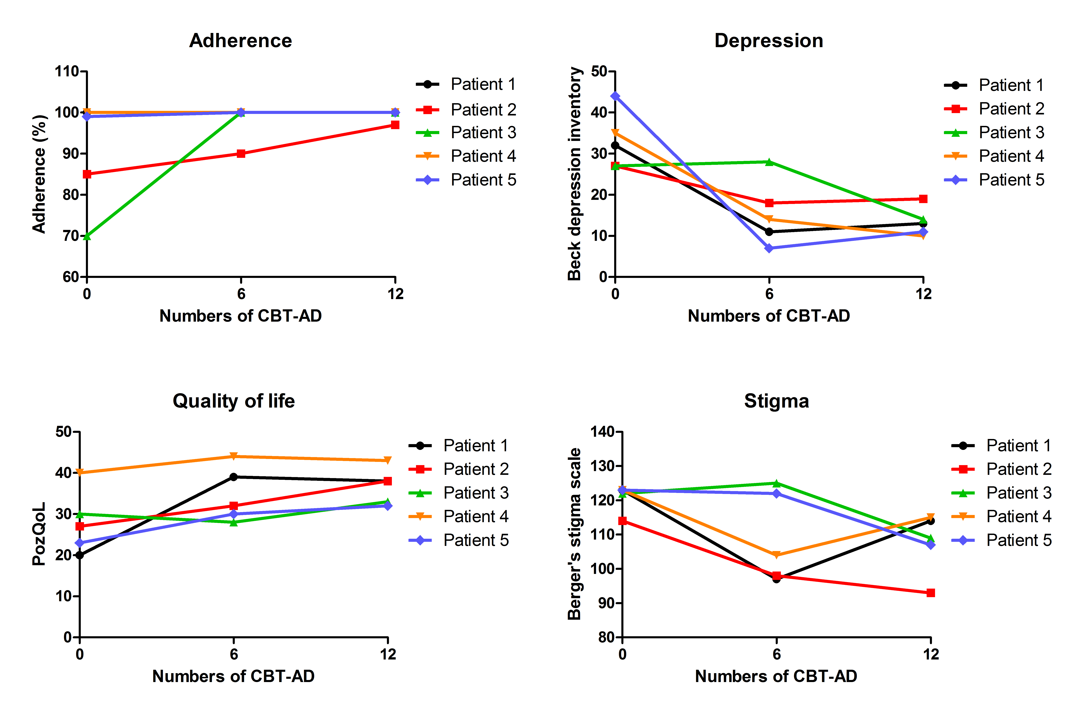
Effects of a nurse-delivered cognitive behavioral therapy on adherence and depressive symptoms of people living with HIV in South Korea
Jung Ho Kim^{1,2}, Ji Min Kim³, Misuk Ye⁴, Jung In Lee³, Seungmi Na¹, Youngjoon Lee⁵, Duncan Short⁶, and Jun Yong Choi^{1,2}
¹ Department of Internal Medicine, Yonsei University College of Medicine; ² AIDS Research Institute, Yonsei University College of Medicine; ³ Division of Infectious Diseases, Severance Hospital; ⁴ Yeoji mind clinic; ⁵ Department of Medical Education, Yonsei University College of Medicine; ⁶ ViiV Healthcare
Poster PED1275
Poster A-AIDS2020-06043
Background
Depressive symptoms are clinically significant problems and are associated with reduced adherence to antiretroviral therapy in people living with HIV (PLWH). Additionally, depression is associated with increased odds of dropping out of HIV care, a primary cause for treatment failure. [1]
Cognitive behavioral therapy focusing on adherence and depression (CBT-AD) performed by clinical psychologists has been found to be an effective treatment for improving depressive symptoms and ART adherence of PLWH [2,3].
However, because access to clinical psychologists is limited in most clinics, CBT-AD is rarely performed for PLWH.
This ongoing study evaluates whether CBT-AD can be effectively performed by a nurse trained and supervised by a clinical psychologist, with a view to wider provision of CBT-AD.
Table 1. Main contents of the program by sessions
Figure 1. Changes of parameters of patients according to CBT-AD Implementation
 | Main contents by sessions
1st session | Introduction of therapist and treatment method General information collection Rapport formation
2nd session | Get an overview of target symptoms through 12 steps Focus on training about the importance of medication prescription Motivation for treatment through interviews
3rd session | Explanation of how cognitive behavioral therapy works Focus on thinking, emotions, and behaviors: explanation and practice of cognitive errors
4th session | Introduction of other cognitive techniques (conversion of perspective, etc.) Introducing behavior activation techniques
5th session | Cognitive technique / behavior activation technique check and correction Behavior test methods introduction Practice of relaxation
6th session | Check and readjust cognitive techniques, behavior activation techniques, and behavior experiment techniques
7th session | Problem solving strategy
8th session | How to cope with stress
9th session | Self-assertion training
10th session | Applying the techniques learned so far on the subject of stigma and self-image
11th session | Supplemental session: Subjects the patient wants to talk about on a voluntary basis (can cover any session from session 3 to session 10)
12th session | Summary of sessions, check changes, and setting of future goals Preventing recurrence and finishing the program
Methods
Study subject
PLWH with depressive symptoms or adherence <90% were enrolled.
Description
For conducting nurse-delivered CBT-AD, a clinical psychologist developed manuals, educated and supervised a nurse.
Education process consisted of 3 X 2 hours sessions of relevant book reading and discussion, 6 X 2 hours sessions of manual education, 14 X 2 hours of supervision. After the manual education, a test was performed to verify qualification.
Then, CBT-AD was conducted once weekly for 12 X 60-minute sessions by a nurse.
Evaluation tools
PLWH were assessed with a visual analog adherence scale (range 0-100%), Beck depression inventory for depressive symptoms (range 0-63, higher score means more depressed), PozQoL for quality of life (ranges 13-65, higher score means higher quality of life), and Berger’s 40-item stigma scale for stigma (range 40-160, the higher the score, the greater the stigma) at baseline, and after the 6th and 12th sessions.
In addition, acceptability and feasibility were evaluated by PLWH and providers through surveys.
Conclusions
Our initial findings suggest that a nurse-delivered CBT-AD can be effective and acceptable for improving depressive symptoms, quality of life, stigma and ART adherence of PLWH.
The implementation of this nurse-delivered intervention should be studied more widely in clinical practice to understand its value and potential contribution to nursing activities.
Results/Lesson learned
To date, five male PLWH have completed 12 sessions of CBT-AD.
Two individuals reported <90% adherence before CBT-AD; both achieved almost 100% adherence after CBT-AD. (figure 1)
All study participants showed reduced depressive symptoms and improved quality of life after CBT-AD.
The stigma scores of participants showed encouraging downward trends.
In a survey regarding acceptability, all study participants felt that they benefitted from CBT-AD.
References
1. Rooks-Peck CR et al. Health Psychol 2018; 37:574–585.
2. Safren SA et al. Lancet HIV. 2016;3(11):e529‐e538.
3. Safren SA et al. J Consult Clin Psychol. 2012;80(3):404‐415.
Funding
This research was funded by ViiV Healthcare
Corresponding Authors
Jung Ho Kim; QETU1111@yuhs.ac
Duncan Short; duncan.x.short@viivhealthcare.com

