Slide 1
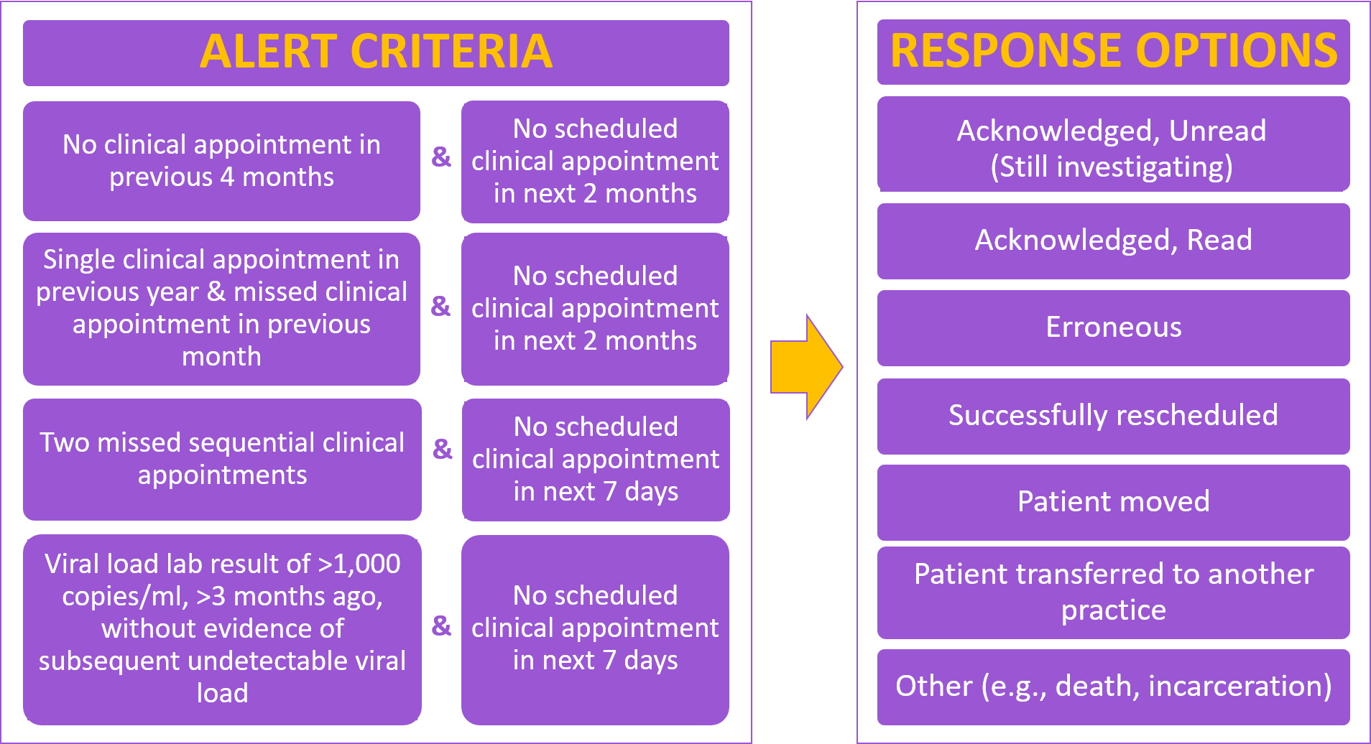
Clinical Decision Support System Alerts for HIV Retention in Care – A Pilot Implementation Research Study
Michael Leonard¹, Rachel Palmieri Weber², Laurence Brunet², Bernard Davis³, Christopher Polk¹, Wesley Thompson⁴, Jennifer Fusco², Tammeka Evans⁵, Pedro Eitz Ferrer⁶, Rodney Mood², Gregory Fusco²
¹Atrium Healthcare, Charlotte, NC; ²Epividian Inc., Durham, NC; ³RAO Community Health, Charlotte, NC; ⁴Amity Medical Group, Charlotte, NC; ⁵ViiV Healthcare, Research Triangle Park, NC; ⁶TBWA\WorldHealth, New York, NY
Background
Methods (continued)
Results
Discussion
Over 8,000 people living with HIV (PLWH) in 2015 in Charlotte, NC¹
76% and 66% retained in care with at least one or two care visits in prior year, respectively
Viral suppression rates matched rate of retention
Clinical decision support system alerts within electronic health record (EHR) system may help retain PLWH who are at-risk of falling out of care by identifying them and providing mechanism for outreach from clinic²
CHORUS™ is a clinical reporting portal translating EHR data into meaningful information for clinicians
Figure 2. Alert criteria and clinic response options
Figure 3a. Alerts and responses over 309 days at Site A
Despite clinics being motivated to increase retention, institutional factors likely impacted utilization of the CHORUS™ alerts, outreach capabilities, and ability to retain at-risk patients after they were identified
Site A: Minimal interactions with alerts, large staff turnover during the after period
Site B: Sporadic interactions with alerts, patient population increased by >30% from the before to the after period
Site C: Dedicated staff member consistently interacting with alerts
Pilot implementation study with ecological design
Measures of retention in care compared over two calendar periods
No adjustment for changes over time in: study populations, clinic characteristics, and policies in place
Not designed to assess effectiveness of the intervention
Lessons learned about clinic dynamics, study design, and data collection to be carried forward in a future study
Objective
Evaluate the feasibility of clinical decision support system alerts in the CHORUS™ clinical reporting portal for retaining HIV-positive patients in care at three HIV clinic sites in a southeastern U.S. city
Figure 3b. Alerts and responses over 352 days at Site B
Figure 3c. Alerts and responses over 246 days at Site C
Methods
Key Findings
Clinical decision support system alerts successfully implemented in CHORUS™ clinical reporting portal, despite suboptimal engagement at some sites
Clinic with dedicated site staff and consistent utilization of alerts experienced improvement in retention of PLWH at-risk of falling out of care
Study Population & Design
Three clinic sites in Charlotte, NC that utilize the CHORUS™ portal
Periods without intervention (before) or with alerts (after) were followed by 3 months of follow up (Figure 1)
Included: PLWH with ≥1 EHR entry in the 2 years before/during the before and after periods (Figure 1)
Intervention
Alerts warning of suboptimal patient attendance generated daily (Figure 2)
Providers or other clinic staff encouraged to reach out to patients identified as at-risk of falling out of care
Statistical Analyses
Alerts, clinic responses to the alerts, and visits (i.e., meeting with provider or HIV lab measurement) were characterized
Proportion of PLWH with ≥1 visit in the before and after periods were compared at each site by Pearson’s Chi-square
References
Smith D. 2015 Ryan White Part A Charlotte Transitional Grant Area (TGA) HIV/AIDS Surveillance Data Update Viral Suppression. 2016. www.mecknc.gov
Robbins GK, Lester W, Johnson KL, Chang Y, Estey G, Surrao D, et al. Efficacy of a clinical decision-support system in an HIV practice: a randomized trial. Ann Intern Med. 2012;157(11):757-66
Figure 4. Summary of results
(N or % of PLWH) | Site A |  | Site B |  | Site C
 | Before | After | Before | After | Before | After
Participants¹ | 10,220 | 9,926 | 538 | 723 | 1,202 | 1,113
Alerts / Responses | --- | 2,245 / 189 | --- | 756 /334 | --- | 1,202 / 896
Ratio of Alerts to Responses | --- | 11.9 | --- | 2.2 | --- | 1.5
≥1 Visit with Healthcare Provider | 46% | 46% | 91% | 80%* | 72% | 81%*
≥2 Visits with Healthcare Provider | 41% | 41% | 85% | 74%* | 64% | 72%*
Acknowledgements
This research would not be possible without the generosity of the OPERA® HIV caregivers and their patients. Additionally, we are grateful for the following individuals: Deb Briney (SAS programming), Jeff Briney (QA), Bernie Stooks (Database Management), and Judy Johnson (Medication Terminology Classification).
Figure 1. Pilot study timeline¹
Eligible if ≥1 EHR entry in this 2-year period |  |  | Follow up² |  | Alerts | Follow up²
 |  | No Alerts
 | Eligible if ≥1 EHR entry in this 2-year period
Contact Information
Rachel Palmieri Weber
(919) 619-3657
rachel.weber@epividian.com
Support
This research was sponsored by ViiV Healthcare.
¹ The before period, without the alert intervention, appears in gold and the after period, with the alert intervention appears in purple
² 3 months in duration
* Statistically significantly different from the before period
¹ A total of 12,230 PLWH were eligible (sites A: 11,271; B: 733; C: 1,344), with >75% in both the before and after periods
IDWeek 2020 | October 21-25, 2020
Notes:
Background:
Clinical decision support system (CDSS) alerts may help retain people living with HIV (PLWH) in care. A system of CDSS alerts utilizing the CHORUS™ portal was developed to identify PLWH at risk of being lost to care. To evaluate feasibility for a larger scale study, a before and after implementation research pilot study was implemented in the OPERA Cohort at three clinic sites in a southeastern US city.
Methods:
Periods without intervention (before) or with CDSS alerts (after) were followed by 3 months of follow up. The study population consisted of PLWH with ≥ 1 electronic health record entry in the 2 years prior to, or during, the before or after period (Fig 1). To support clinicians through a discrete implementation strategy, alerts warning of suboptimal patient attendance were generated daily for the eligible PLWH at each site; providers or other clinic staff could respond to the alerts (Fig 2). Alerts, responses, and visits (i.e. meeting with provider or HIV lab measurement) were characterized. The proportion of PLWH with ≥ 1 visit in the before and after periods were compared at each site by Pearson’s Chi-square.
Results:
A total of 12,230 PLWH were eligible (sites A: 11,271; B: 733; C: 1,344 PLWH), with > 75% in both the before and after periods. The ratio of alerts to responses was 11.9 at site A (2,245 alerts to 189 responses in 309 days; Fig 3A), and comparatively lower at sites B (756 alerts to 334 responses in 352 days, ratio=2.2; Fig 3B) and C (1,305 alerts to 896 responses in 246 days, ratio=1.5; Fig 3C). Responses to alerts were sporadic at sites A and B and consistent at site C. After the intervention, the proportion of PLWH with ≥ 1 visit stayed the same at site A (46% in both periods; p=0.47), decreased at site B (91% to 80%; p< 0.01), and increased at site C (72% to 81%; p< 0.01).
Conclusions:
This pilot study was ecological by design: measures of retention in care were compared over two calendar periods, without accounting for changes in study populations, clinic characteristics, and policies in place over time (which could have impacted clinic attendance). Though engagement with the CDSS was suboptimal at some sites, this implementation pilot study has demonstrated the ability to implement a CDSS aimed at identifying at-risk PLWH, while highlighting areas for improvement in future larger scale studies.

