Slide 1
Text messaging between providers and patients living with HIV in South Carolina: Barriers and facilitators to implementation
Virginia Fonner, PhD, MPH (Co-PI)
Department of Psychiatry and Behavioral Science
Medical University of South Carolina

Slide 2
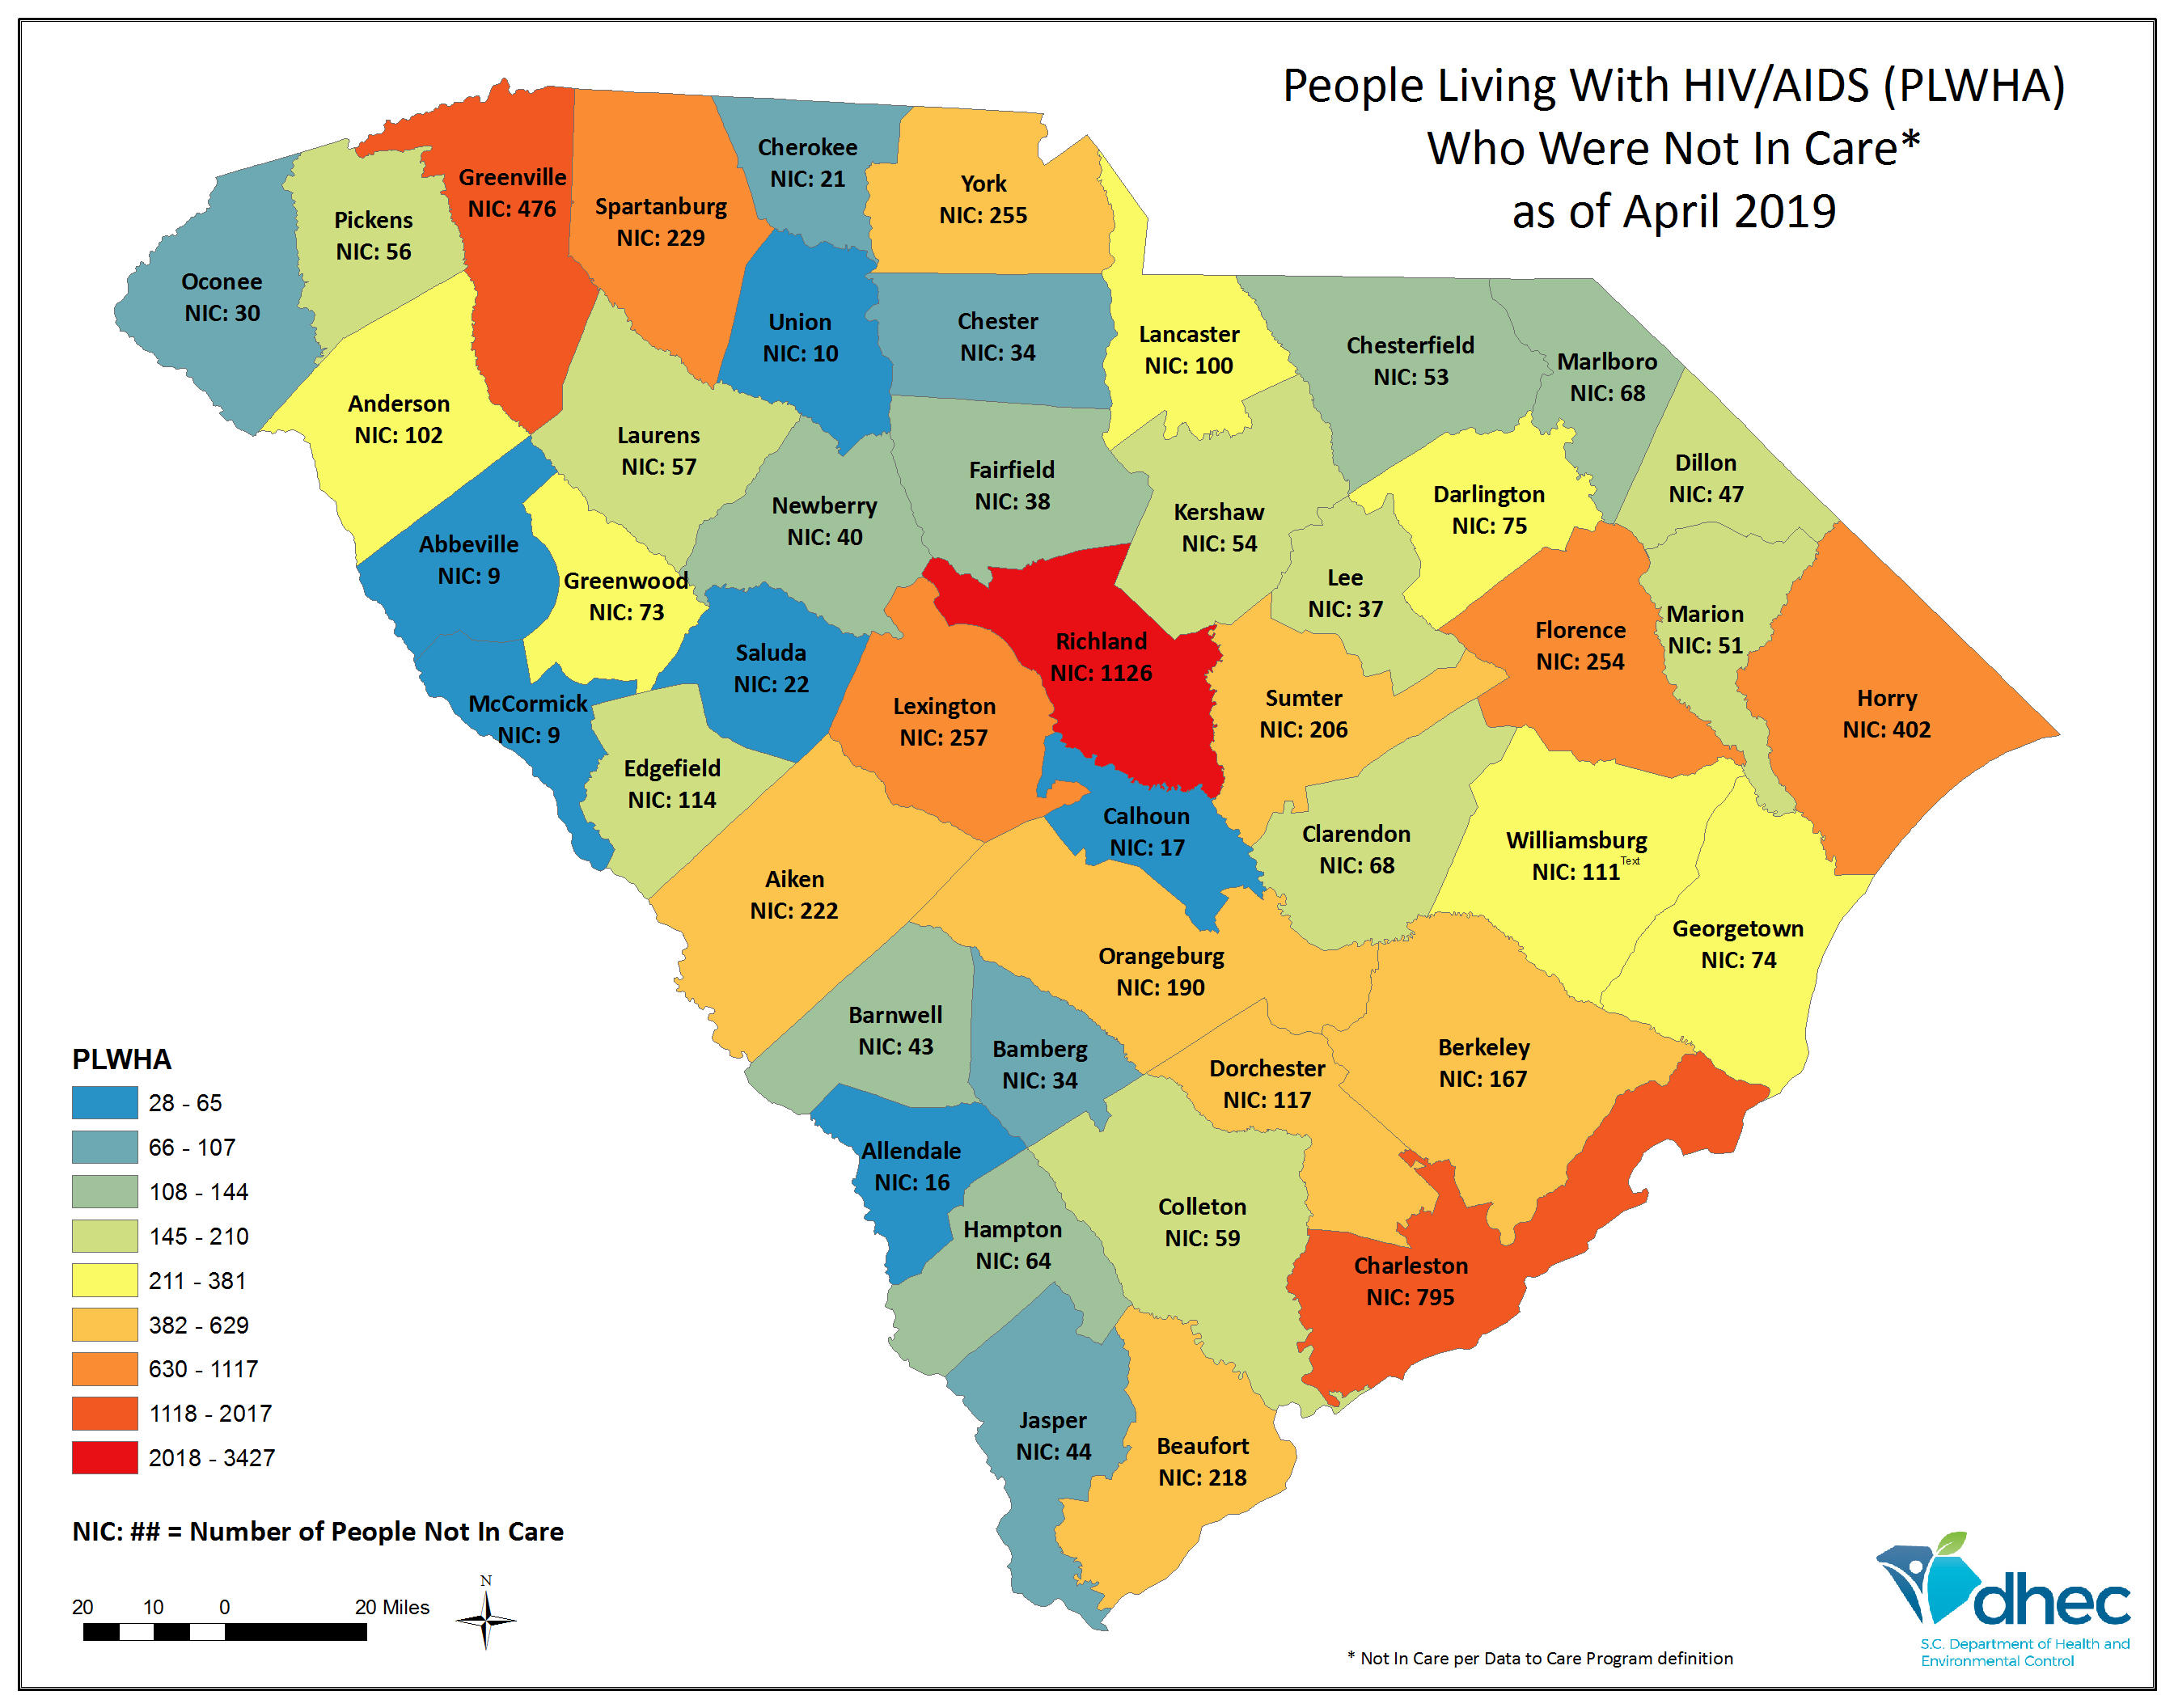
Background
~20,000 people living with HIV in South Carolina
Only ~50% are retained in continuous HIV-related medical
~750 new infections per year
Sustained HIV treatment ➔healthy patients ➔ no onward transmission
Communication vital to patient engagement and retention

Slide 3
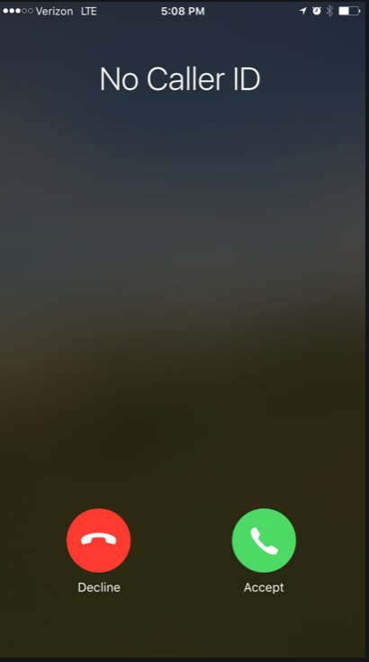
Background
MUSC HIV Clinic: ~1,200 patients
~250 patients receive case management services
An estimated 95% have cell phones; 75% have smart phones
Current clinic operations:
Landline telephones used for communication, but:
Patients decline to answer calls from blocked numbers
Voice mailboxes are full or have not been set-up
Providers play phone tag all day
Patients ask to be texted, not called

Slide 4
Hypothesis and aim
Hypothesis: Having the capacity to text between patients and clinic providers (specifically case managers and pharmacists) will improve:
Linkage and retention in clinical care
Patient satisfaction with clinical services
Research Aim: To understand acceptability, preferences, and barriers/facilitators to texting among patients and providers
Included assessing preference for encrypted app (Qliq) vs. standard texting

Slide 5
Qliq vs. plain texting
 | Text messaging | Qliq
Ease of use | On all phones | App (free for patients)
Contacts | Same as on phone | Separate contacts Account requires name and phone number or email
Sending a message | Type and hit “send” | Type and hit “send”
Privacy | Based on phone privacy settings | Passcode protected Can remotely delete messages if device is lost or stolen HIPAA compliant (messages are encrypted)
Receive notifications | Yes | Yes, might need to configure settings

Slide 6
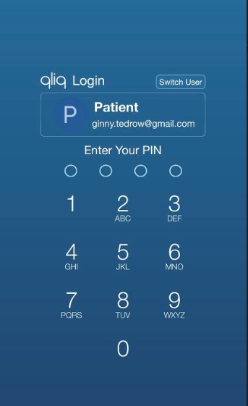
Qliq
Can change status (“online,” “away,” or “do not disturb”)
Can see when someone has read a text
Can request acknowledgement
Standard way of typing and sending messages. Can also send pictures

Slide 7
Methods
Semi-structured in-depth interviews with patients (n=12) and providers (n=14)
Purposeful sampling (variation of provider role and patient age/gender)
Interviews included:
Open-ended questions related to CFIR domains
Demonstration of a secure texting app (Qliq)
Close-ended Likert scale questions related to intervention acceptability
Interviews transcribed, coded using deductive and emergent codes
Thematic analysis

Slide 8
Methods
Formative phase of larger, mixed-methods study
Phase 1: Developmental formative evaluation
Phase 2: Implementation of text/video chat
(12 months)
Phase 3: Interpretative formative evaluation

Slide 9
Results: Sample characteristics
Patients (n=12)
Providers (n=14)
Characteristic | % in sample
Gender | 42% male 50% female 8% gender fluid
Race/ethnicity | 83% African American
Age, mean (range) | 39.5 (23-57)
Phone access | 100% smart phones
Role | N (%)
Social Support Provider (Case Managers, Social Workers, Outreach) | 6 (43%)
Medical Provider (Physicians, PAs, Pharmacists) | 5 (36%)
Support Staff (Nurse Administrators, Coordinators, Program Support) | 3 (21%)

Slide 10
Quantitative Results: Acceptability
Strongly disagree (1)
Strongly agree (5)
I would like to use this form of communication frequently.
Providers and patients should have the capacity to text with each other.
Trying to implement a system to allow texting between patients is too complex and not worth the time and risk.
Most patients would be interested in communicating by text with their case manager or pharmacist.
4.1
4.4
4.0
4.4
1.6
1.9
4.3
4.5
= patients
No significant differences (p<0.05) between patients and providers’ perceptions
= providers

Slide 11
Outer setting: Meeting patient needs
Most patients (92%) and providers (86%) favored having text messaging as mode of communication
Patient Perspective
“…phone calls get drawn on and then get still and I be like, ‘okay miss, is that it?’ But that's,
it sucks for it to be like that cause I know she only calling for my best interest but I am not the
phone talking guy…I would rather text all day.” –African American male patient, 26 years old
Provider Perspective
“You know that people will text, but maybe they're not answering their phone, maybe they don't
want to talk... they would just rather text…I'm hoping it [text messaging] will be an efficient and
time reducer, I guess, in terms of wasting time trying to get people that I feel like the chances
might be greater with a text sort of solution. ” –Social Support Provider

Slide 12
Perceived benefits of text messaging
Benefits | Exemplary quotes
Quick and efficient | “Send it, shoot it, it's quicker communication.” –Social Support Provider
Convenient | “Well that'd [text messaging] be good, especially on like days when I'm at work. Instead of that phone ringing and I'm like, ‘Oh I can't.’ This way here [acts like checking a text], ‘Oh okay’.” –African American female patient, 57 years old
Ease of use | “…if somebody texts you, it's easy to text them back at your convenience.” –White/Native American female patient, 36 years old

Slide 13
Perceived challenges of text messaging
Challenges | Exemplary quotes
Impersonality | “I feel as though texting loses emotion…People don't see my concern over text.” —Medical Provider
Expectations of instant access (provider) | “…Texting implies that you have my full attention and I'm at your disposal anytime, anywhere.” –Medical Provider
Potential for overutilization (provider) | “…Please don't send me 15 text messages in one day.” –Social Support Provider
Privacy and security | “There's always an element of concern for someone who's HIV positive that somebody's gonna find out their status that they don't want to know their status.” –Social Support Provider
Cost and access | “…Some people have monthly bills for phone plans. They have unlimited. Some people have minutes and stuff.” –African American male patient, 33 years old

Slide 14
Provider vs. patient perspectives in technology preference
Providers thought patients would prefer plain texting; concerned with access
Providers deferential to patients needs/preferences
Providers and patients agreed security was a benefit of using Qliq
“If that's the way you want to communicate with me, I'm all for it. If it'll get you to answer my questions, you do what I want you to, then sure. ” –Social Service Provider
“You have kids, you have family members who doodle in your phone. They can read the text, everybody else’s text. But when it comes to your health and your privacy, there should be an app that is created just for that.” –African American male patient, 37 years old

Slide 15
Technology Preference: App vs. Plain Texting
Patients
10/12 (83%) preferred Qliq
Providers
Qliq preferred but more variation
Prefers using the patient portal instead
Plain texting
Prefers both methods available
Qliq
No preference
Plain texting

Slide 16
Provider vs. patient perspectives in technology preference
Patient portal and text messaging redundant? Some providers thought so, patients disagreed.
Separateness of Qliq seen as beneficial but concern over message visibility
I see [text messaging] as a better improvement 'cause when I go through the MUSC patient care app like every six months you gotta get a new password and its like, ‘I don't want to get a new password. Just show me when the next doctor's appointment is coming up’.” –African American female patient, 47 years old
“Obviously they would have to get those push notifications, or it wouldn't work.”
–Social Support Staff

Slide 17
Privacy and Security
Agreement on what should never be sent by text
Providers concerned about “HIPAA violations” and “PHI”. Patients were not
Patients mainly trusted providers to be discreet
“Probably the three little words—H.I.V.” –White/Native American female patient, 36 yrs old
“…You can control what you send out to patients, but you can't control what patients send back to you.” –Social Support Staff
“You just have to be confident with yourself and trust and know your staff. So to me, I think it's a trust factor. And me, I trust them 100 percent.” –African American female, 39 yrs old

Slide 18
What information to send by text?
Some patients wanted medical information sent by text, not others
Providers wanted short, general messages
Patients and providers liked using texting for quick check-ins
…She'll [the case manager] get information about my lab work before I do…she could just send me a text message and be like ‘hey this changed, this improved’” –African American male, 26 yrs
“Just a simple text and not a detailed text. We're not trying to give a dissertation about the client’s medical history. We just want to give them simple instructions.” –Social Services Provider
“I would think just a short check in as far as text …like, "Hey, are you doing okay? Is there anything I can help with?" – White gender-fluid patient, 38 years

Slide 19
Results summary
Text messaging acceptable and helps meet patient needs
Benefits: quick, efficient, convenient, easy
Challenges: Security; perception of instant access; overutilization; impersonality; cost and access
Too efficient? Too convenient? Advantages raise complexity (potential for disruption) and compatibility issues (Increased work load? Altered work flow?)
Using secure app preferred over plain text messaging
Frequency of engagement and information exchange is a two-way street

Slide 20
Implications for D&I Research
Unique challenges of implementing bidirectional intervention
One size does not fit all
Wide variations in expected use by patients and concern of overuse/unreasonable expectations by providers
Patient perspective more critical than most institutionally-initiated interventions
Questions:
How to match patient/provider expectations and use?
Determining fidelity?
Addressing provider and patient perspectives in implementation frameworks?

Slide 21
Implications for D&I Research
Implementation research ➔ community/institutional buy-in
Involvement of patients and providers gave voice/stake in project
Institution has no formal policy on texting in clinical settings
Text messaging in research context more acceptable than for clinical purposes
Sparked institutional recognition of need to formulate text messaging policy

Slide 22
Implications for D&I Research
Results from formative work used to develop text messaging intervention
Use of encrypted, HIPAA-compliant app
Plain texting allowed for those without smart phones
Intervention “rules” provided to patients prior to enrollment
Ex: Providers will try to respond within 1 business day
Implementation indicators being collected
…stay tuned for results!

Slide 23
THANK YOU!
Funding source: Viiv Healthcare
Research team: Eric Meissner, MD, PhD (co-PI), Lisa Martin (coordinator), Samuel Kennedy and Christie Eichberg (data collectors)
All participants
Email: fonner@musc.edu

