Slide 1
RUKOBIA Fostemsavir Educational Series
For healthcare professionals only

Slide 2
Adverse event reporting and prescribing information
ViiV Healthcare is an independent HIV company, committed to delivering innovative new options for the care and treatment of people living with HIV/AIDS. It is vital for us to continuously monitor the safety of our products and medicine.
Adverse events should be reported. Reporting forms and information can be found at https://yellowcard.mhra.gov.uk/. Adverse events should also be reported to ViiV Healthcare.
To report a suspected side effect to ViiV Healthcare, please use our online reporting form hosted on www.gsk.com
For local contact details, please select your home market in the drop-down list on the form.
Prescribing information can be found at the end of the module
Link to AE reporting can be accessed in your viewing platform

Slide 3
For healthcare professionals only
NX-GBL-FST-PPT-230001
Date of preparation: January 2023

Slide 4
The Story of Fostemsavir
Max Lataillade
Head of Global Research Strategy
ViiV Healthcare
Co-inventor of Fostemsavir (Rukobia™)
John Kadow
NX-GBL-FST-PPT-230001
Date of preparation: January 2023

Slide 5
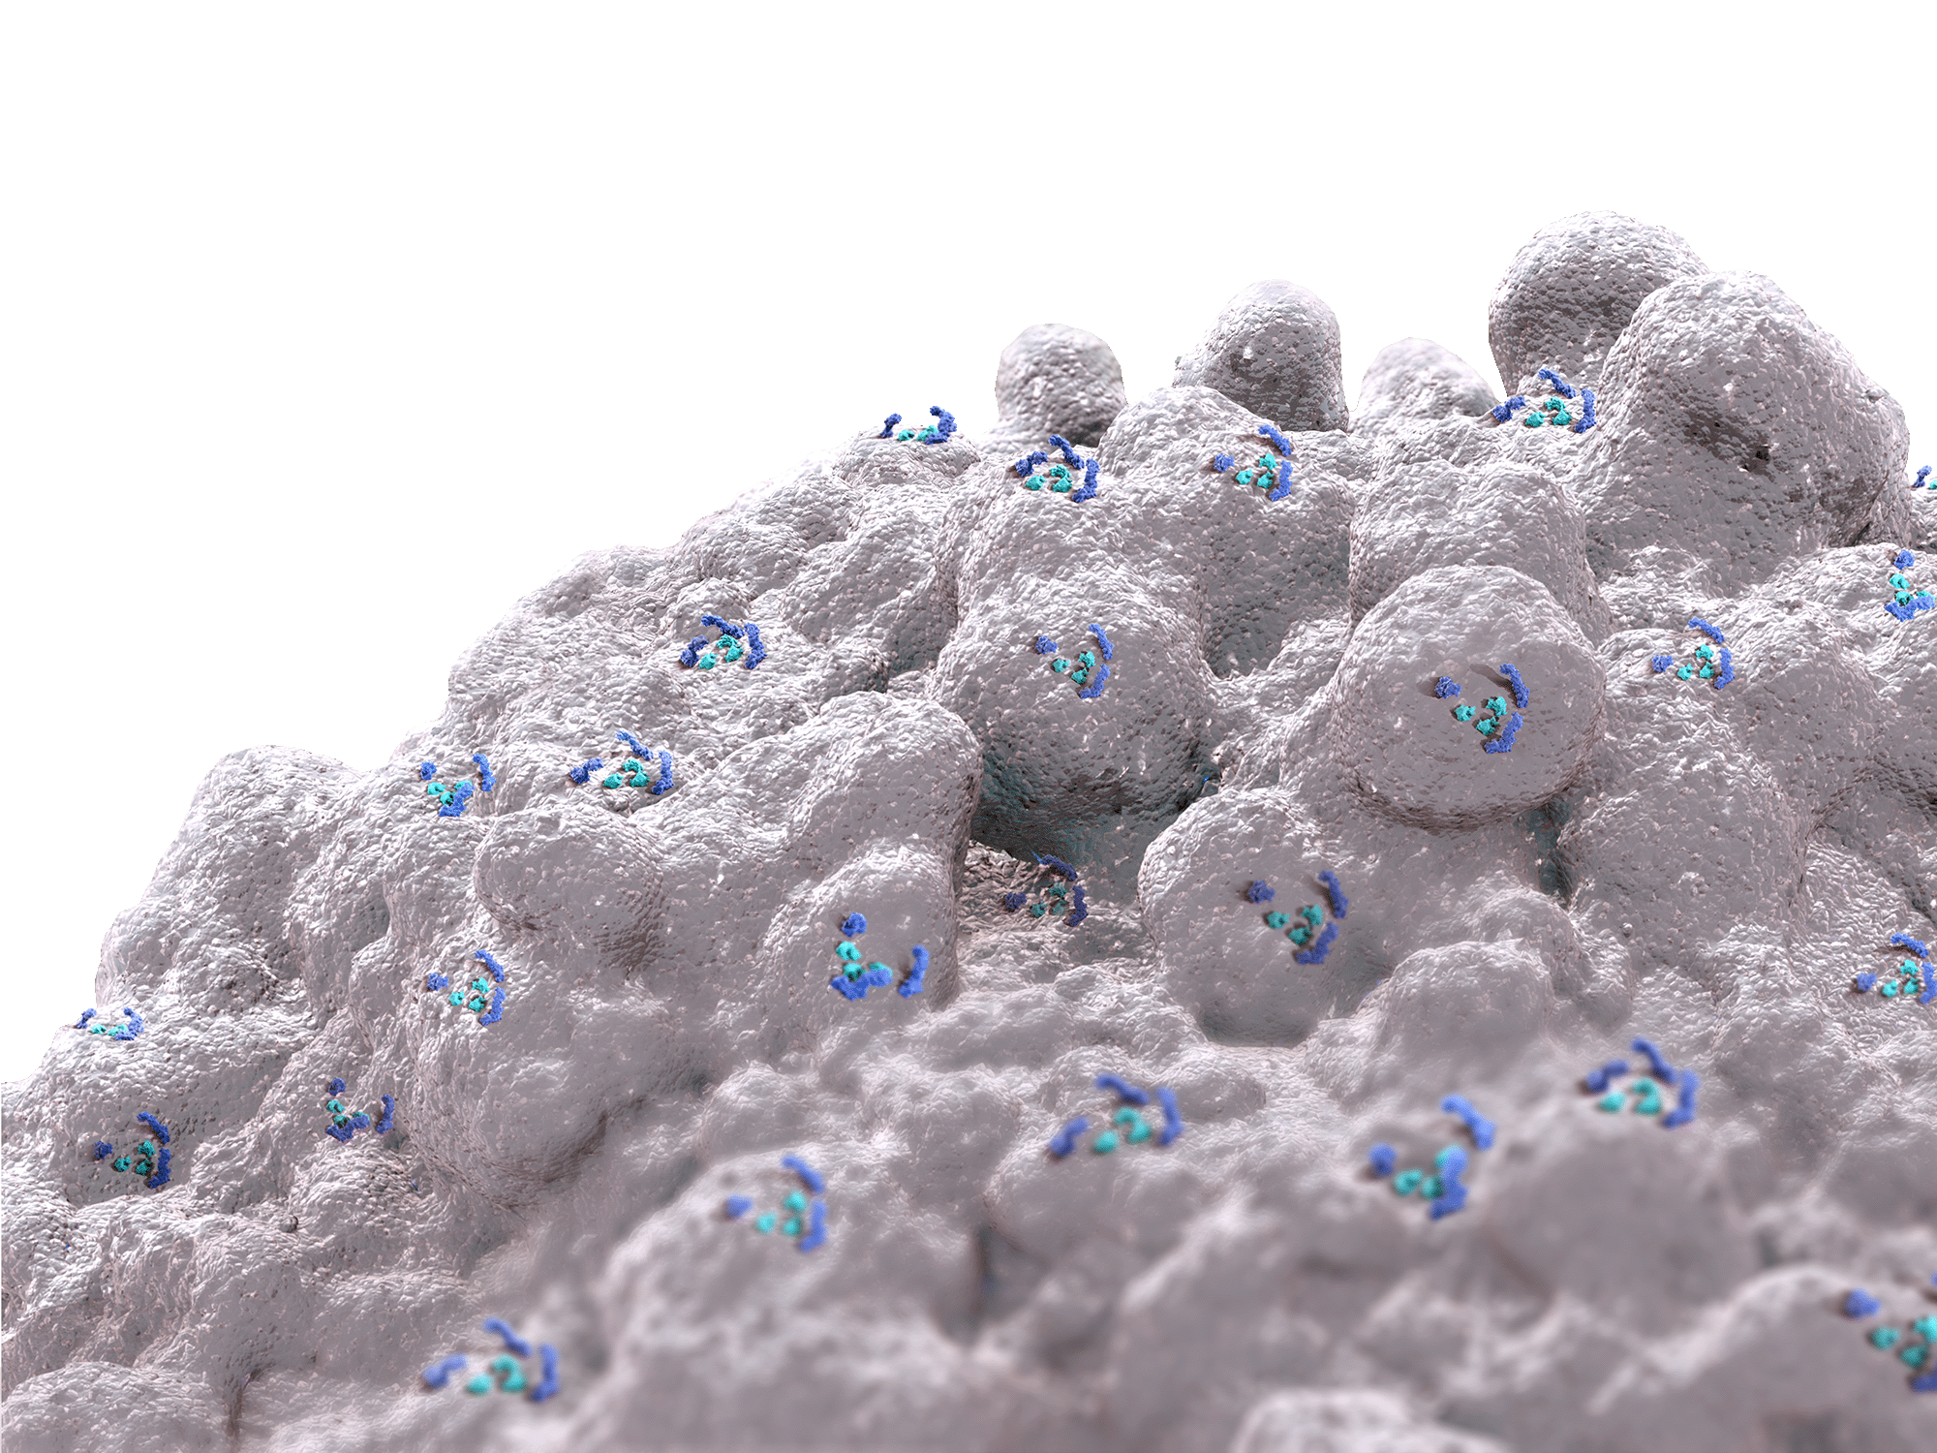
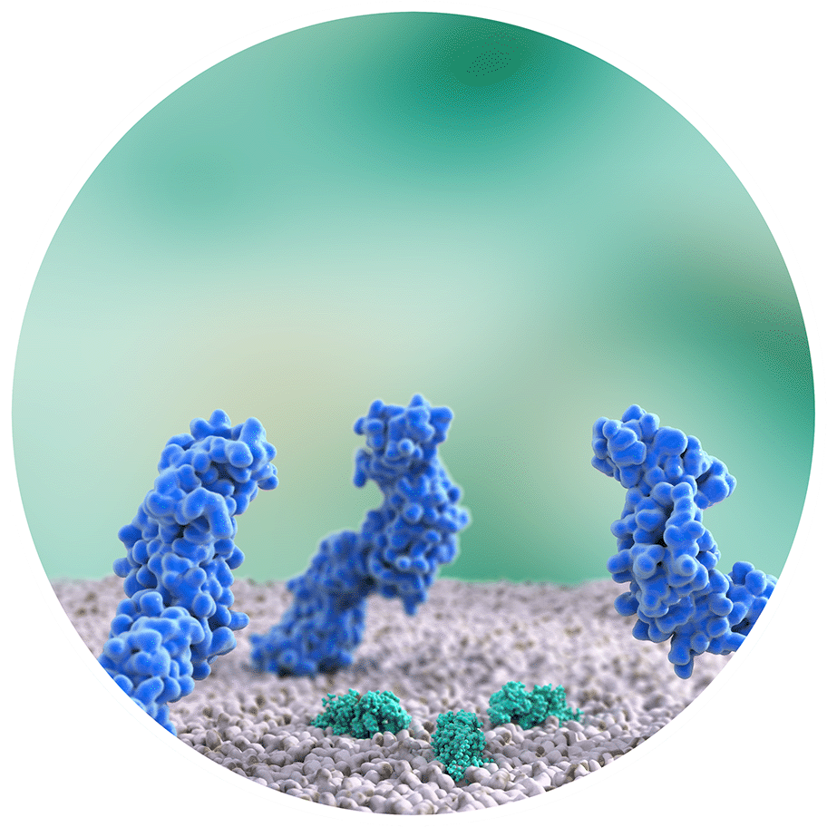
Fostemsavir extended-release tablet
Unique mechanism of action
First-in-class HIV-1 attachment inhibitor, with unique MoA¹
First ART to prevent HIV-1 attachment to CD4+ T cells, protecting CD4+ T cells and other immune cells¹
First oral ART approved for treating adults with MDR HIV-1, for whom it is otherwise not possible to construct a suppressive anti-viral regimen²
CD4 receptor
CCR5/CXCR4
1. Kozal M, et al. N Engl J Med 2020;382:1232–43
2. Rukobia Summary of Product Characteristics. Available at: https://www.ema.europa.eu/en/documents/product-information/rukobia-epar-product-information_en.pdf. Accessed October 2022
ART, antiretroviral therapy; CD4+, cluster of differentiation 4-positive; MDR, multidrug resistant MoA, mechanism of action

Slide 6
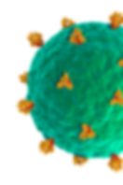
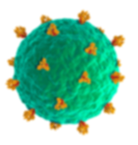
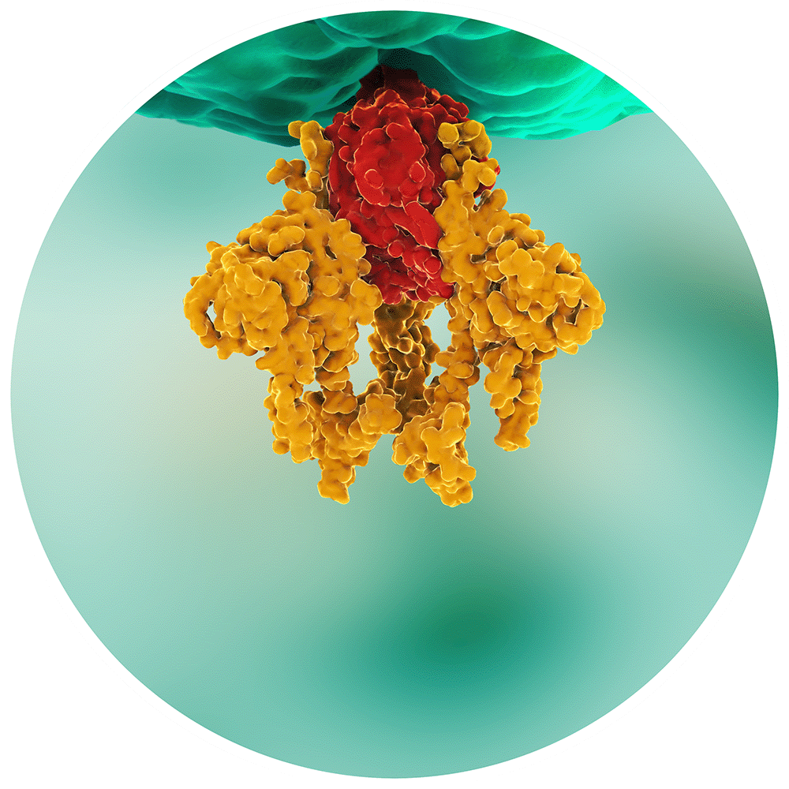
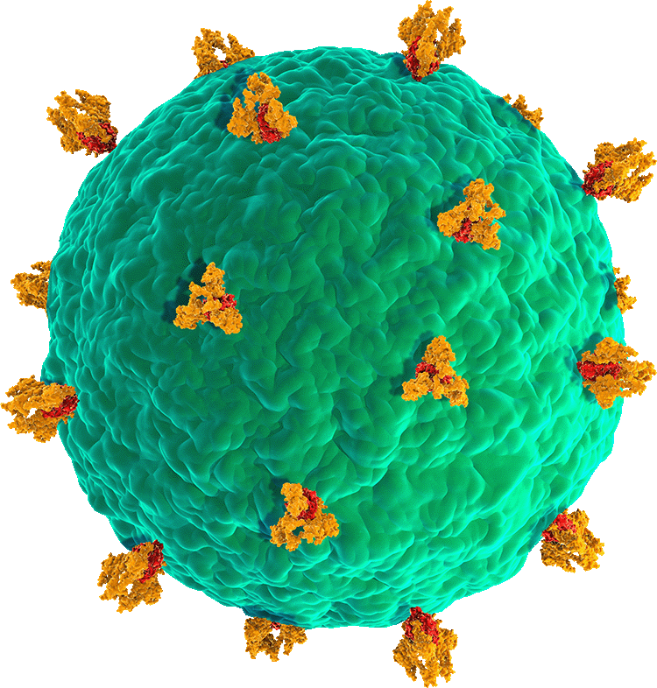
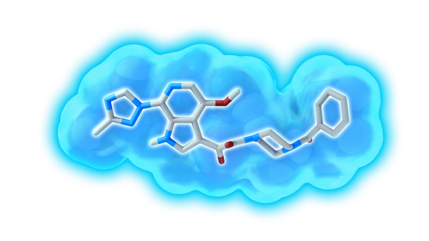
Unique MoA
gp120 trimer
gp41 trimer
gp160
CD4 receptor
CCR5/CXCR4
CCR5, C-C chemokine receptor type 5; CXCR4, C-X-C chemokine receptor type 4
Kozal M, et al. N Engl J Med 2020;382:1232–43

Slide 7
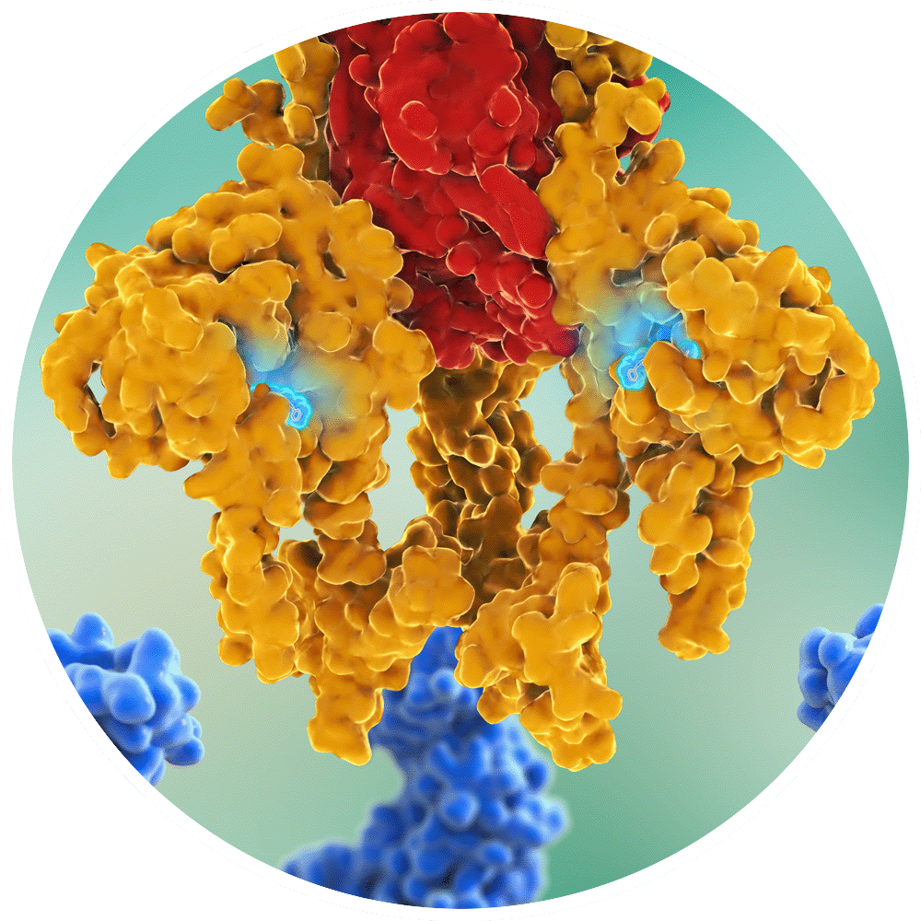
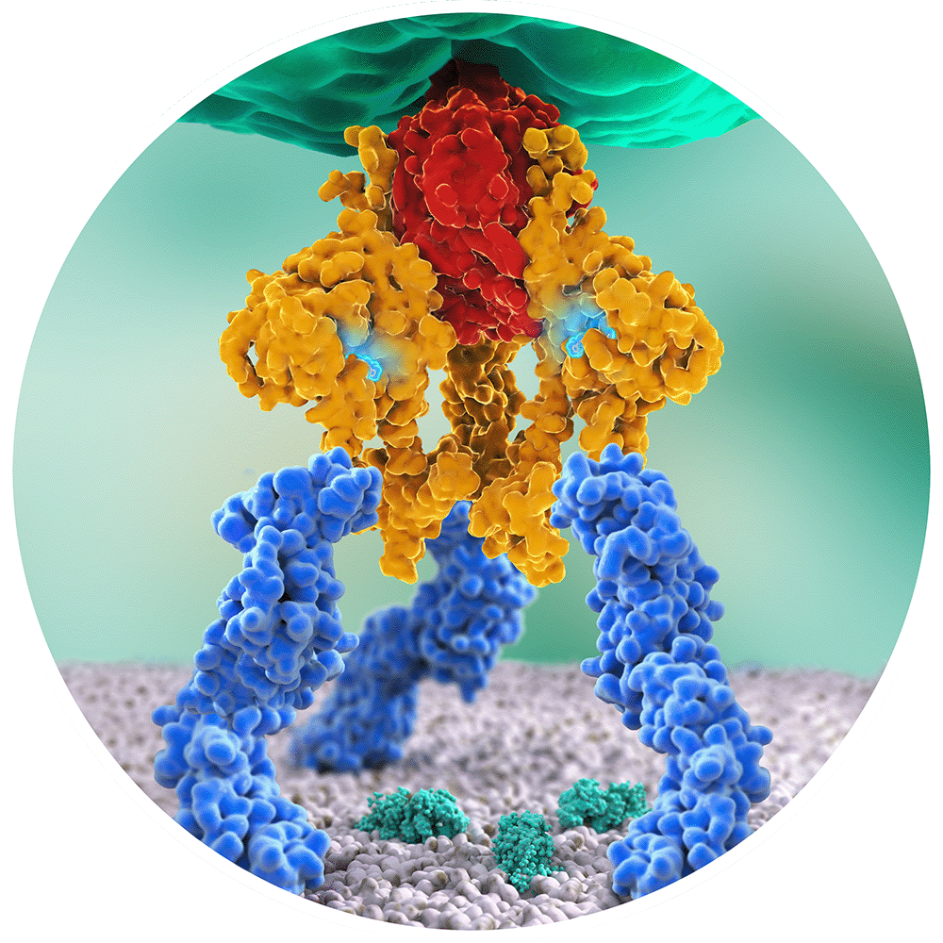
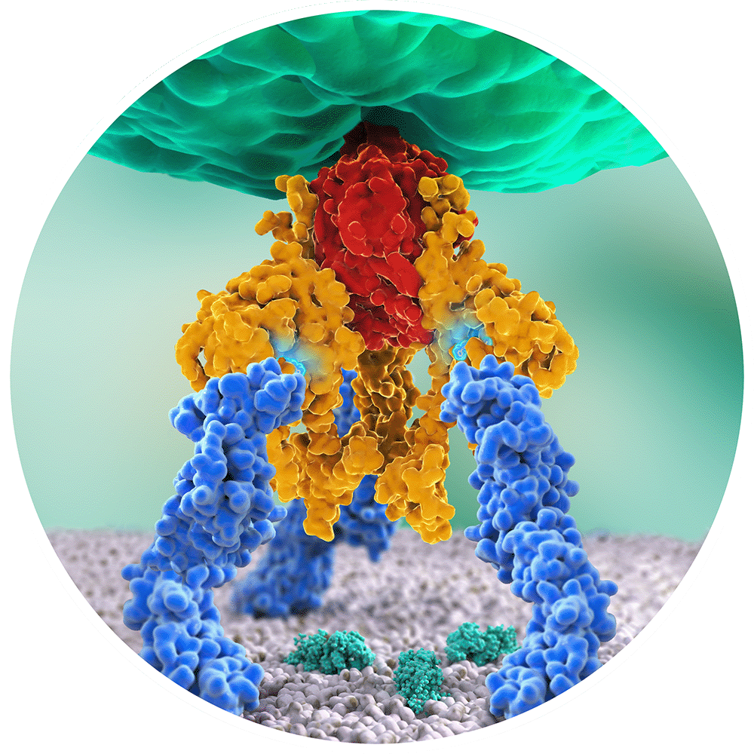
Unique MoA
CD4 binding site
Temsavir binds near the CD4 binding site, preventing gp120 conformational change and inhibiting HIV-1 attachment
Temsavir
Kozal M, et al. N Engl J Med 2020;382:1232–43

Slide 8
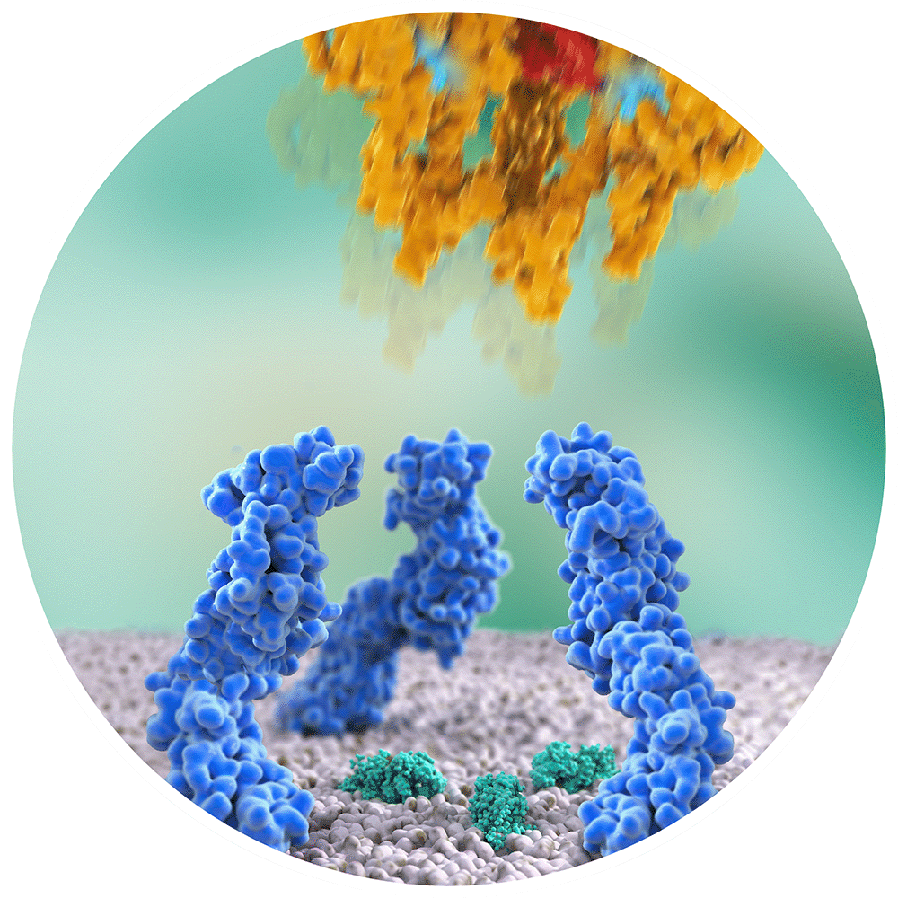
Unique MoA
Virus attachment is inhibited
Kozal M, et al. N Engl J Med 2020;382:1232–43

Slide 9
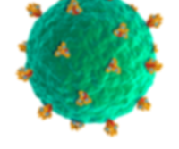
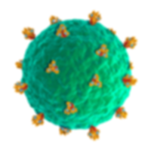
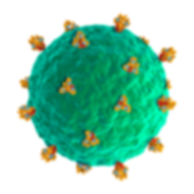
Unique MoA
Viruses cannot enter cells and accumulate in the extracellular space.
They are subsequently removed by the host immune system
Kozal M, et al. N Engl J Med 2020;382:1232–43

Slide 10
Adults living with MDR HIV-1 have significant unmet needs and may pose major clinical challenges
People living with MDR HIV-1^{1,2}
Unmet needs
Required drug attributes
ART toxicity
MDR HIV-1
Poor adherence
Suboptimal ART
Long-term survivors
Multiple co-morbidities
Drug–drug interactions
Complex regimens
1. Priest J, et al. Open Forum Infect Dis 2021;8:ofab562
2. Cutrell J, Jodlowski T, Bedimo R. Ther Adv Infectious Dis 2020;7:1–15

Slide 11
Adults living with MDR HIV-1 have significant unmet needs and may pose major clinical challenges
People living with MDR HIV-1
Unmet needs^{1–4}
Required drug attributes
MDR HIV-1 with risk of transmission and disease progression
Exhausted ART options
High resource utilisation
High burden of disease
High mortality
Life expectancy further reduced by low CD4+ nadir⁴
Mortality higher in those with poor CD4+ T-cell recovery during ART²
By pre-ART CD4+ T-cell count
ART-CC and COHERE
CD4+ T-cell count (cells/mm³) after 3 years of ART
80
20-year reduction in life expectancy with CD4+ nadir <350 cells/mm³
Of ~20 million people on ART globally, the vast majority started ART at CD4+ T-cell count <350 cells/mm³
100
68.6
>500
60
58.4
351–500
48.8
46.9
201–350
40.8
Survival probability, %
40
90
63% non-AIDS
causes of death
Years
31.4
≤200 (15% of cohort)
20
≥350 cells/mm³
10-year mortality
for CD4 <200: ~25%
~2.5%
per year
<350 cells/mm³
80
0
2000– 2002
2003– 2005
2006– 2007
0
1
2
3
4
5
6
Years after index date
ART-CC, Antiretroviral Therapy Cohort Collaboration; COHERE, Collaboration of Observational HIV Epidemiological Research Group
1. Cutrell J, Jodlowski T, Bedimo R. Ther Adv Infectious Dis 2020;7:1–15. 2. Engsig FN, et al. Clin Infect Dis 2014;58:1312–21
3. Althoff KN, et al. Lancet HIV 2019;6:e93–104. 4. Samji H, et al. PLoS One 2013;8:e81355

Slide 12
Adults living with MDR HIV-1 have significant unmet needs and may pose major clinical challenges
People living with MDR HIV-1²
People living with MDR HIV-1
Unmet needs^{3–6}
Unmet needs
Required drug attributes^{3,7}
Required drug attributes^{1,2}
Novel class and new MoA
No cross resistance to existing ART
Ability to maintain or increase CD4+ T cell count
Tolerable safety profile in the setting of multiple co-morbidities and organ dysfunction
Manageable drug–drug interaction profile
1. Cutrell J, Jodlowski T, Bedimo R. Ther Adv Infectious Dis 2020;7:1–15
2. Lataillade M, et al. Lancet HIV 2020;7:e740–51

Slide 13
Clinical development journey Two decades in the making – from pharmacology to clinic
BRIGHTE study Week 240 data presented at International AIDS Conference, Montreal. 2022⁶
BRIGHTE study primary endpoint met and data presented at EACS conference³
Human testing starts
GSK/ViiV involvement in FTR begins
US FDA approval⁴
2005
2016
2017
2020
2022
2000
2015
2017–19
2019
2021
Development starts. >5,000 samples tested; only 1 viable
BRIGHTE study begins (Phase III study)¹
Investment in new manufacturing facilities dedicated to FTR²
US FDA filing in December
EU EMA approval⁵
1. Kozal M, et al. N Engl J Med 2020;382:1232–43. 2. European Pharmaceutical Review. Expediating the set-up of a manufacturing site: Rukobia case study. Available at: https://www.europeanpharmaceuticalreview.com/article/152108/expediting-the-set-up-of-a-manufacturing-site-rukobia-case-study/. Accessed October 2022. 3. Althoff KN, et al. Lancet HIV 2019;6:e93–104. 4. Rukobia Prescribing Information, July 2020. Available at: https://www.accessdata.fda.gov/drugsatfda_docs/label/2020/212950s000lbl.pdf. Accessed October 2022. 5. Rukobia Summary of Product Characteristics. Available at: https://www.ema.europa.eu/en/documents/product-information/rukobia-epar-product-information_en.pdf. Accessed October 2022. 6. Aberg J, et al. 24th International AIDS Conference 2022. Poster EPB160
GSK, GlaxoSmithKline; EACS, European AIDS Clinical Society; EMA, European Medicines Agency; EU, Europe; FDA, US Food and Drug Administration; FTR, fostemsavir; US, United States

Slide 14
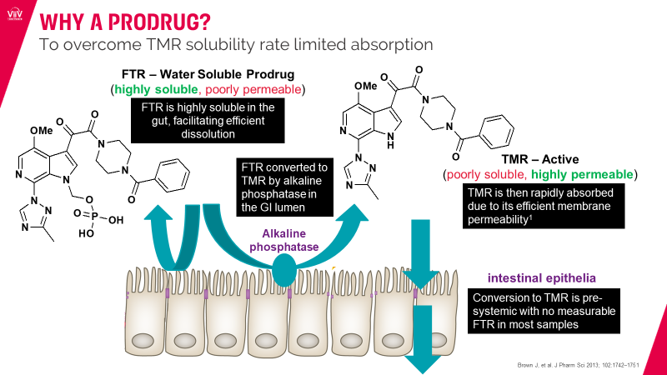
FTR clinical development journey Two decades in the making – from pharmacology to clinic
Why an extended release formulation?
To lower C_{max} (from 11,026 to 1,693 for immediate release to extended release)
To prolong absorption by extending t_{max} (from 1.5–2 to 4–5 hours for immediate release to extended release)
To extend t_{½} (from 3.2–4.5 to 7–14 for immediate release to extended release)
2000
Development starts. >5,000 samples tested; only 1 viable
2004^{1,2}
2006²
GI, gastrointestinal; C_{max}, maximum concentration; t_{1/2}, terminal half life; t_{max}, time to maximum drug concentration; TMR, temsavir
1. Brown J, et al. J Pharm Sci 2013;102:1742–51
2. Muccini C, et al. Drug Des Devel Ther 2022;16:297–304

Slide 15
Clinical development journey Two decades in the making – from pharmacology to clinic
BRIGHTE: Study design^{1,2}
In the baseline HIV-1 RNA >1000 c/mL subgroup (n=182), FTR participants demonstrated from baseline to Day 8¹:
Median decrease in HIV-1 RNA of 1.02 log₁₀
>0.5 log₁₀ decrease in 68%
>1 log₁₀ decrease in 50%
HTE participants failing current regimen with confirmed HIV-1 RNA ≥400 c/mL and
Day 1
Primary endpoint
Day 8
Day 9
Week 24
Week 48
Week 96
Week 192
Week 240‡
Randomized Cohort*
1 or 2 ART classes remaining with ≥1 approved fully active agent per class
Unable to construct viable regimen from remaining approved agents
Blinded
FTR 600 mg
BID + failing
regimen
R 3:1
Open-label FTR 600 mg BID + OBT
Blinded
placebo +
failing
regimen
Non-randomized Cohort*
0 ART classes remaining and no remaining approved fully active agents†
Non-randomized
Open-label FTR 600 mg BID + OBT†
Day 1
Week 24
Week 48
Week 96
Week 192
Week 240‡
COVID-19: from Dec 2019
*There were no screening temsavir susceptibility criteria. †Use of investigational agents as part of OBT was permitted in the Non-randomized Cohort only. ‡The study is expected to be conducted until participants can access FTR through other means (eg, marketing approval).
2015
BRIGHTE study begins (Phase III study)^{1,3}
2016
GSK/ViiV involvement in FTR begins
2017
BRIGHTE study primary endpoint met and data presented at EACS conference^{3,4}
BID, twice daily; c/mL, copies/mL; COVID-19, coronavirus disease; HTE, heavily treatment-experienced; OBT, optimized background therapy; R, randomized;
1. Kozal M, et al. N Engl J Med 2020;382:1232–43. 2. Aberg J, et al. 24th International AIDS Conference 2022. Poster EPB160 3. Lataillade M, et al. Lancet HIV 2020;7:e740–51. 4. Althoff KN, et al. Lancet HIV 2019;6:e93–104

Slide 16
Clinical development journey Two decades in the making – from pharmacology to clinic
2017–19
Investment in new manufacturing facilities dedicated to FTR¹
2020
US FDA approval²
2021
EU EMA approval³
1. European Pharmaceutical Review. Expediating the set-up of a manufacturing site: Rukobia case study. Available at: https://www.europeanpharmaceuticalreview.com/article/152108/expediting-the-set-up-of-a-manufacturing-site-rukobia-case-study/. Accessed October 2022
2. Rukobia Prescribing Information, July 2020. Available at: https://www.accessdata.fda.gov/drugsatfda_docs/label/2020/212950s000lbl.pdf. Accessed October 2022 3. Rukobia Summary of Product Characteristics. Available at: https://www.ema.europa.eu/en/documents/product-information/rukobia-epar-product-information_en.pdf. Accessed October 2022.

Slide 17
Clinical development journey Two decades in the making – from pharmacology to clinic
Baseline characteristics¹
Parameter | Randomized (N=272) | Non-randomized (N=99) | Total (N=371)
HIV-1 RNA log₁₀ c/mL, median (range) | 4.7 (1.6–6.9) | 4.3 (1.6–6.6) | 4.6 (1.6–6.9)
HIV-1 RNA, n (%), c/mL <400 400 to <1,000 1,000 to <100,000 ≥100,000 | 21 (8) 10 (4) 161 (59) 80 (29) | 5 (5) 4 (4) 75 (76) 15 (15) | 26 (7) 14 (4) 236 (64) 95 (26)
CD4+ T-cell count, median (range), cells/mm³ | 99.5 (0–1,160) | 41.0 (0–641) | 80.0 (0–1,160)
CD4+ T-cell count, n (%), cells/mm³ <20 20 to <50 50 to <200 200 to <500 ≥500 | 72 (26) 25 (9) 102 (38) 58 (21) 15 (6) | 40 (40) 14 (14) 25 (25) 18 (18) 2 (2) | 112 (30) 39 (11) 127 (34) 76 (20) 17 (5)
AIDS history, n (%)* | 231 (85) | 89 (90) | 320 (86)
*History of AIDS = yes if participant had nadir CD4+ T-cell count <200 cells/mm³ or if response to “Does participant have AIDS?” on disease history CRF was yes
2022
BRIGHTE study Week 240 data presented at International AIDS Conference 2022¹
CRF, circulating recombinant form
1. Aberg J, et al. 24th International AIDS Conference 2022. Poster EPB160

Slide 18
Clinical development journey Two decades in the making – from pharmacology to clinic
Antiviral efficacy and CD4+ T-cell count recovery¹
HIV-1 RNA <40 c/mL through Week 240 by Snapshot analysis (ITT-E) and observed analysis
In the Randomized Cohort, virologic response rates (HIV-1 RNA <40 c/mL by snapshot analysis [ITT-E]) generally remained consistent through Week 240
Reduced virologic response rates by Snapshot at Week 192 and beyond were partially confounded by missing data due to the impact of COVID-19: at Week 240, 19 (7%) participants in the Randomized Cohort and 5 (5%) in the Non-randomized Cohort were counted as virologic failures for this reason
Randomized Cohort
ITT-E population
Observed analysis
Non-randomized Cohort
ITT-E population
Observed analysis
Proportion of participants, %
*
†
ITT-E participants without an HIV-1 RNA value at the relevant time point or those who changed OBT due to lack of efficacy up to each time point counted as failures; *ITT-E population, N=267; †ITT-E population, N=92
Week
Lower virologic suppression by Snapshot analysis beyond Week 192 was partially confounded by missing data due to COVID-19
2022
BRIGHTE study Week 240 data presented at International AIDS Conference 2022¹
ITT-E, intention-to-treat exposed
1. Aberg J, et al. 24th International AIDS Conference 2022. Poster EPB160

Slide 19
Clinical development journey Two decades in the making – from pharmacology to clinic
Antiviral efficacy and CD4+ T-cell count recovery¹
Mean change in CD4+ T-cell count from baseline through Week 240 (observed analysis)
Change in CD4+ T-cell count from baseline to Week 240 by virologic response at the same time point (Randomized Cohort, observed analysis)
Randomized Cohort (N=272)
Non-randomized Cohort (N=99)
Mean (SD) change from baseline in CD4+ T-cell count, cells/mm³
Mean change from baseline in CD4+ T-cell count, cells/mm³
Week
Week
N=
Virologic response, N=
Randomized Cohort
248
228
213
197
179
139
<40 c/mL
145
142
161
139
134
103
Non-randomized Cohort
87
83
65
53
45
31
≥40 c/mL
102
86
50
56
45
36
2022
BRIGHTE study Week 240 data presented at International AIDS Conference 2022¹
SD, standard deviation
1. Aberg J, et al. 24th International AIDS Conference 2022. Poster EPB160

Slide 20
Clinical development journey Two decades in the making – from pharmacology to clinic
Antiviral efficacy and CD4+ T-cell count recovery¹
In the Randomized Cohort:
78% (73/94) of participants with baseline CD4+ T-cell count of <200 cells/μL had an increase in CD4+ T-cell count of ≥200 cells/μL at Week 240
67% (22/33) of participants with a baseline CD4+ T-cell count of <20 cells/μL had an increase in CD4+ T-cell count of ≥200 cells/μL at Week 240
Mean change in CD4+ T-cell count through Week 240 by baseline CD4+ T-cell category (Randomized Cohort, observed analysis)
Baseline CD4+ T-cell count
<20 (n=72)
20 to <50 (n=25)
50 to <100 (n=39)
100 to <200 (n=63)
Mean change from baseline in CD4+ T-cell count, cells/mm³
≥200 (n=73)
2022
BRIGHTE study Week 240 data presented at International AIDS Conference 2022¹
1. Aberg J, et al. 24th International AIDS Conference 2022. Poster EPB160

Slide 21
Clinical development journey Two decades in the making – from pharmacology to clinic
Antiviral efficacy and CD4+ T-cell count recovery¹
Mean CD4+/CD8+ ratio through Week 240 (observed analysis)
Randomized Cohort (N=272)
Incidence of non-AIDS-defining events for participants with:¹⁴
Mean CD4+/CD8+ ratio increased steadily from baseline (0.2) to Week 240 (0.6) in the Randomized Cohort
Non-randomized Cohort (N=99)
CD4:CD8 ratio of >0.45: 1.9 per 100 participant-years (95% CI: 1.6, 2.2)
Mean (SD) CD4+/CD8+ ratio
CD4:CD8 ratio of 0.30–0.45: 2.2 per 100 participant-years (95% CI: 1.7, 2.9)
CD4:CD8 ratio of <0.30: 4.2 per 100 participant-years (95% CI: 3.4, 5.3)
A ratio <0.30 was independently associated with an increased risk of non-AIDS-defining events or death compared with a ratio of >0.45
N=
Week
Randomized Cohort
248
228
213
197
179
139
Non-randomized Cohort
87
83
65
53
45
31
2022
BRIGHTE study Week 240 data presented at International AIDS Conference 2022¹
CD8+, cluster of differentiation 8-positive; CI, confidence interval
1. Aberg J, et al. 24th International AIDS Conference 2022. Poster EPB160

Slide 22
Clinical development journey Two decades in the making – from pharmacology to clinic
Summary of Week 240 safety data¹
Parameter, n (%) | Randomized Cohort (N=272) |  | Non-randomized Cohort (N=99) |  | Total (N=371)
 | Week 96 | Week 240 | Week 96 | Week 240 | Week 96 | Week 240
Any AE | 249 (92) | 259 (95) | 98 (99) | 98 (99) | 347 (94) | 357 (96)
Any Grade 2–4 AE | 216 (79) | 242 (89) | 87 (88) | 94 (95) | 303 (82) | 336 (91)
Drug-related Grade 2–4 AEs | 57 (21) | 65 (24) | 22 (22) | 23 (23) | 79 (21) | 88 (24)
Any Grade 3–4 AE | 78 (29) | 110 (40) | 49 (49) | 60 (61) | 127 (34) | 170 (46)
Any SAE | 92 (34) | 122 (45) | 48 (48) | 55 (56) | 140 (38) | 177 (48)
Drug-related SAEs | 9 (3) | 10 (4) | 3 (3) | 3 (3) | 12 (3) | 13 (4)
Any AE leading to D/C | 14 (5) | 17 (6) | 12 (12) | 13 (13) | 26 (7) | 30 (8)
Any CDC Class C event | 23 (8) | 25 (9) | 15 (15) | 19 (19) | 38 (10) | 44 (12)
Deaths | 12 (4) | 15 (6) | 17 (17) | 20 (20) | 29 (8) | 35 (9)
The safety profile was consistent with earlier findings across both cohorts
During the study, 25/371 participants were diagnosed with COVID-19 and COVID-19-related events
All cases resolved without reported sequelae, and there were no COVID-19-related deaths or reports of post-COVID-19 syndrome
The most common AEs leading to discontinuation were related to infections (n=12; 3%)
2022
BRIGHTE study Week 240 data presented at International AIDS Conference 2022¹
AE, adverse event; CDC, Centers for Disease Control and Prevention; D/C, discontinued; SAE, serious adverse event
1. Aberg J, et al. 24th International AIDS Conference 2022. Poster EPB160

Slide 23
The clinical impact A first-in-class ART in a patient living with HIV who has limited treatment options
61-year-old African American female living with AIDS and MDR HIV-1*
FTR + DTG + OBT†
100,000
800
HIV viral load
CD4+ T-cell count
700
10,000
600
HIV viral load HIV RNA c/mL
500
1,000
CD4+ T-cell count, cells/µL
400
100
300
<40 limit of detection by quantitative PCR
10
200
100
1
1
0
4
8
16
24
36
48
60
72
84
168
180
192
204
228
Weeks
2 cells/µL CD4/CD8 ratio 0.005
745 cells/µL CD4/CD8 ratio 0.824
Weight increased from 53 kg to 73 kg
*Adapted from a real case in the BRIGHTE trial, for illustrative purposes only †OBT was dolutegravir BID, darunavir/ritonavir BID, tenofovir/emtricitabine QD
DTG, dolutegravir; PCR, polymerase chain reaction; QD, once daily

Slide 24
The clinical impact A first-in-class ART in a patient living with HIV who has limited treatment options
61-year-old African American female living with AIDS and MDR HIV-1*
FTR + DTG + OBT†
CD4:CD8 ratio
Incidence of non-AIDS-defining events for participants with:¹
CD4:CD8 ratio of >0.45: 1.9 per 100 participant-years (95% CI: 1.6, 2.2)
CD4:CD8 ratio at Week 228: 0.824
CD4:CD8 ratio of 0.30–0.45: 2.2 per 100 participant-years (95% CI: 1.7, 2.9)
CD4:CD8 ratio of <0.30: 4.2 per 100 participant-years (95% CI: 3.4, 5.3)
A ratio <0.30 was independently associated with an increased risk of non-AIDS-defining events or death compared with a ratio of >0.45
CD4:CD8 ratio on Day 1: 0.005
Day 1 and 8‡
Week
*Adapted from a real case in the BRIGHTE trial, for illustrative purposes only †OBT was dolutegravir BID, darunavir/ritonavir BID, tenofovir/emtricitabine QD ‡The first two time points denote Days 1 and 8 of the blinded treatment period
1. Mussini C, et al. Lancet HIV 2015;2:e98–106

Slide 25
RUKOBIA prescribing information
Rukobia fostemsavir 600 mg prolonged release tablets See Summary of Product Characteristics (SmPC) before prescribing
Indications: Adults with multidrug resistant HIV-1 infection (in combination with other antiretroviral medications) for whom it is otherwise not possible to construct a suppressive antiviral regimen. Dosing: Adults (over 18 years): 600 mg twice daily, with or without food, swallowed whole with water – do not crush, chew or split the tablets. Elderly: No dosage adjustment required. (Limited data in 65+ yrs). No dosage adjustment required in renal or hepatic impairment. Contraindications: Hypersensitivity to any ingredient. Coadministration with strong CYP3A inducers including, but not limited to: carbamazepine, phenytoin, mitotane, enzalutamide, rifampicin and St John’s Wort. Special warnings and precautions: See SmPC for full details. Rukobia is not recommended for treatment of infections due to HIV-1 Group M subtype CRF01_AE strains. Risks of immune reconstitution inflammatory syndrome, opportunistic infections, osteonecrosis. Use with caution in patients with a history of QT interval prolongation, when co-administered with a medicine with a known risk of Torsade de Pointes (e.g. amiodarone, disopyramide, ibutilide, procainamide, quinidine, or sotalol) or in patients with relevant pre-existing cardiac disease. Elderly patients may be more susceptible to drug-induced QT interval prolongation. Monitor LFTs in hepatitis B and/or C co-infection. Co-administration with elbasvir/grazoprevir is not recommended. Use with caution when co-administered with statins that are substrates for OATP1B1/3 or BCRP, and consider dose modifications.
Doses of co-administered oestrogen-based therapies should not exceed 30 μg/day of ethinyl oestradiol. Caution is advised particularly in patients with additional risk factors for thromboembolic events. The recommended dose of co-administered tenofovir alafenamide (TAF) is 10mg. Pregnancy/lactation: Avoid use of Rukobia during pregnancy as data are limited. Do not breast-feed. Side effects: See SmPC for full details. Diarrhoea, headache, nausea, rash, abdominal pain, vomiting, immune reconstitution inflammatory syndrome, insomnia, dizziness, somnolence, dysgeusia, QT prolongation, dyspepsia, flatulence, pruritus, myalgia, fatigue, and increases in transaminases, creatinine and CPK.
Trademarks are owned by or licensed to the ViiV Healthcare group of companies.
SmPC: https://www.ema.europa.eu/en/medicines/human/EPAR/rukobia
Prescribing information for ViiV Healthcare products is available here: https://viivhealthcare.com/en-us/our-medicines/ or via your ViiV Healthcare contact
Adverse events should be reported. For the UK, reporting forms and information can be found at www.mhra.gov.uk/yellowcard or search for MHRA Yellowcard in the Google Play or Apple App store. Adverse events should also be reported to GlaxoSmithKline on 0800 221441.
Link to AE reporting can be accessed in your viewing platform

Slide 26
DOVATO prescribing information
Dovato – dolutegravir 50 mg/lamivudine 300 mg tablets See Summary of Product Characteristics (SmPC) before prescribing
Indications: HIV-1 in adults & adolescents above 12 years of age weighing ≥40kg, with no known or suspected resistance to the integrase inhibitor class, or lamivudine. Dosing: One tablet once daily with or without food. Use an additional 50mg tablet of dolutegravir approximately 12 hours after the dose of Dovato when co-administered with efavirenz, nevirapine, tipranavir/ritonavir, etravirine (without boosted PI), carbamazepine, oxcarbazepine, phenytoin, phenobarbital, St John’s Wort or rifampicin. Elderly: Limited data in 65+ yrs. Not recommended in patients with creatinine clearance < 50 mL/min. Caution in severe hepatic impairment. Contraindications: Hypersensitivity to any ingredient. Coadministration with substrates of OCT-2 with narrow therapeutic windows, such as fampridine. Special warnings and precautions: See SmPC for full details. Risk of hypersensitivity reactions. Discontinue dolutegravir and other suspect agents immediately. Risks of osteonecrosis, immune reactivation syndrome, increased weight, lipids and glucose. Monitor LFTs in Hepatitis B/C coinfection and ensure effective Hepatitis B therapy. Caution with metformin: monitor renal function and consider metformin dose adjustment. Use with etravirine requires boosted PI or increased dose of dolutegravir. Use with Mg/Al-containing antacids requires dosage separation. Use with calcium, multivitamins or iron also requires dosage separation if not taken at the same time with food. Use with cladribine or emtricitabine not recommended. When possible, avoid chronic co-administration of sorbitol or other osmotic acting alcohols. If unavoidable, consider more frequent viral load monitoring. Pregnancy/lactation: The safety and efficacy have not been studied in pregnancy. Women of childbearing potential should be counselled about the potential risk of neural tube defects with dolutegravir (a component of Dovato), including consideration of effective contraceptive measures.
If a woman plans pregnancy, the benefits and the risks of continuing treatment with Dovato should be discussed with the patient. If a pregnancy is confirmed in the first trimester while on Dovato, the benefits and risks of continuing Dovato versus switching to another antiretroviral regimen should be discussed with the patient taking the gestational age and the critical time period of neural tube defect development into account. Most neural tube defects occur within the first 4 weeks of embryonic development after conception (approximately 6 weeks after the last menstrual period). Dovato may be used during the second and third trimester of pregnancy when the expected benefit justifies the potential risk to the foetus. Do not breastfeed. Side effects: See SmPC for full details. Headache, GI disturbance, insomnia, abnormal dreams, depression, anxiety, dizziness, somnolence, rash, pruritus, alopecia, fatigue, arthralgia, myalgia, hypersensitivity, suicidal ideation or suicide attempt, hepatitis, blood dyscrasias, acute hepatic failure, increased bilirubin, pancreatitis, angioedema, rhabdomyolysis, lactic acidosis, peripheral neuropathy. Elevations of ALT, AST and CPK.
Trademarks are owned by or licensed to the ViiV Healthcare group of companies.
SmPC: https://www.ema.europa.eu/en/medicines/human/EPAR/dovato
Prescribing information for ViiV Healthcare products is available here: https://viivhealthcare.com/en-us/our-medicines/ or via your ViiV Healthcare contact
Adverse events should be reported. For the UK, reporting forms and information can be found at www.mhra.gov.uk/yellowcard or search for MHRA Yellowcard in the Google Play or Apple App store. Adverse events should also be reported to GlaxoSmithKline on 0800 221441.
Link to AE reporting can be accessed in your viewing platform

Slide 27
Thank you for watching

