Slide 1
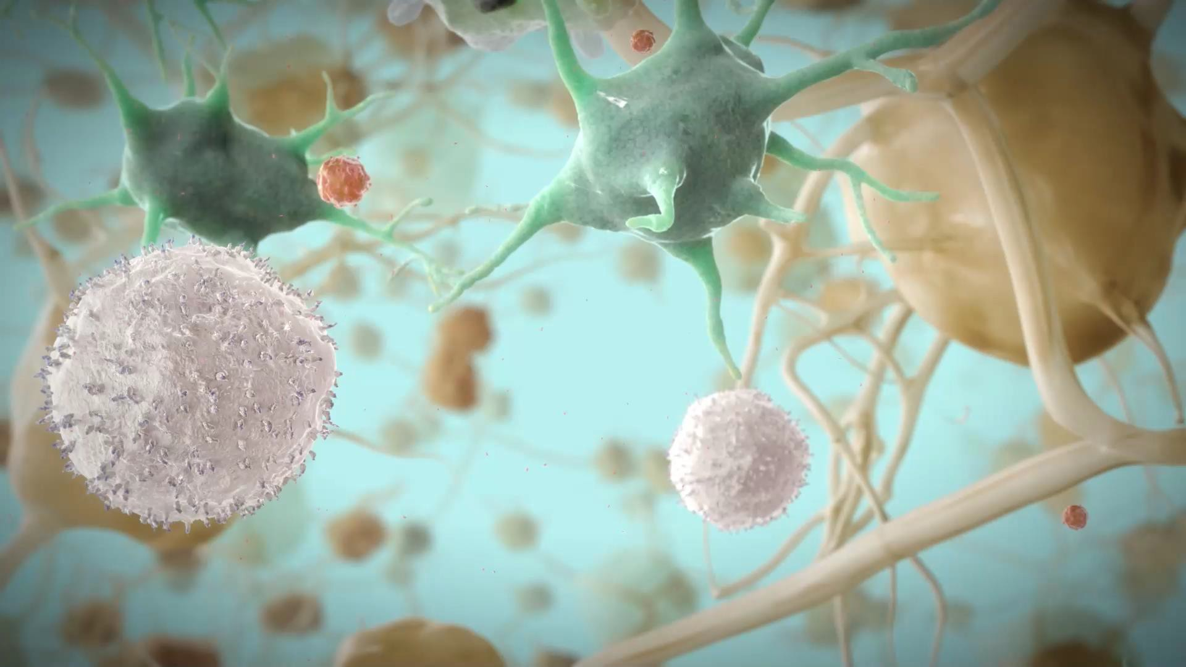
For Healthcare Professionals only
NX-GBL-HVX-PPT-230010
Date of preparation: March 2023

Slide 2
Adverse event reporting and prescribing information
ViiV Healthcare is an independent HIV company, committed to delivering innovative new options for the care and treatment of people living
with HIV/AIDS. It is vital for us to continuously monitor the safety of our products and medicine.
Adverse events should be reported. Reporting forms and information can be found at https://yellowcard.mhra.gov.uk/. Adverse events should also be reported to ViiV Healthcare.
To report a suspected side effect to ViiV Healthcare, please use our online reporting form hosted on www.gsk.com
For local contact details, please select your home market in the drop-down list on the form.
Prescribing information can be found at the end of the module
Link to AE reporting can be accessed in your viewing platform

Slide 3
The consequences of a persistently low CD4 T cell count in the management of HIV-1 infection
Presented by Andrew Clark – Global Medical Lead, ViiV Healthcare
NX-GBL-HVX-PPT-230010
Date of preparation: March 2023

Slide 4
Outline
The role of CD4 T cells in HIV-1 infection
The impact of low CD4 count on mortality and morbidity
Inflammation
Immune non-response
Summary
4

Slide 5
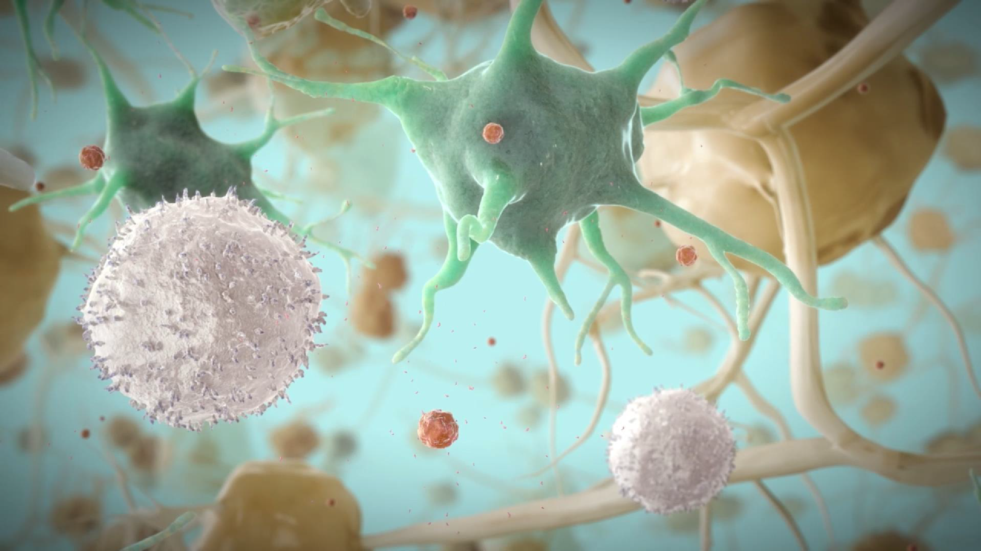
The role of CD4 T cells in HIV-1 infection¹
Th1
Th2
Th17
Tfh
Treg
Macrophage activation Inflammation
Eosinophils and B cell activation
Inflammation, recruiting
of neutrophils
Guide B cells to produce antibodies
Immune response suppression
Th1, T helper type 1; Th2, T helper type 2; Th17, T helper type 17; Tfh, T follicular helper; Treg, regulatory T cell
1. Appay V, Sauce D and Kelleher AD. HIV Infection as a Model of Accelerated Immunosenescence. In: Fulop T et al (eds). Handbook on Immunosenescence. Cham: Springer Nature AG. 2019. pp. 1961–89

Slide 6
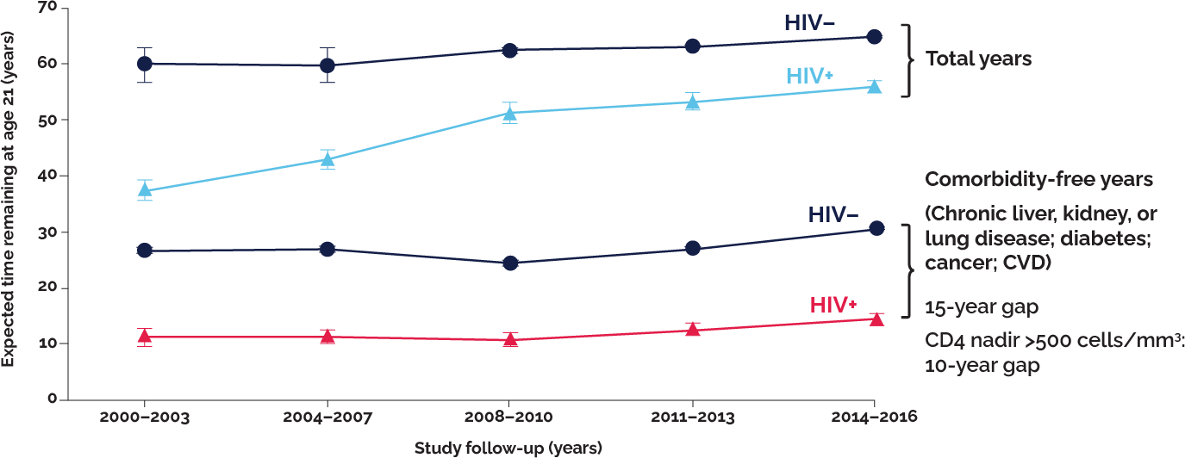
The risk of comorbidities remains unchanged despite advances in treatment
The comorbidity gap still lags even in those with high CD4 nadirs²
20-year reduction in life expectancy with CD4 nadir
<350 cells/mm³
CVD, cardiovascular disease
2. Marcus JL et al. Comparison of overall and comorbidity-free life expectancy between insured adults with and without HIV infection, 2000–2016. JAMA Netw Open 2020;3:e207954
6

Slide 7
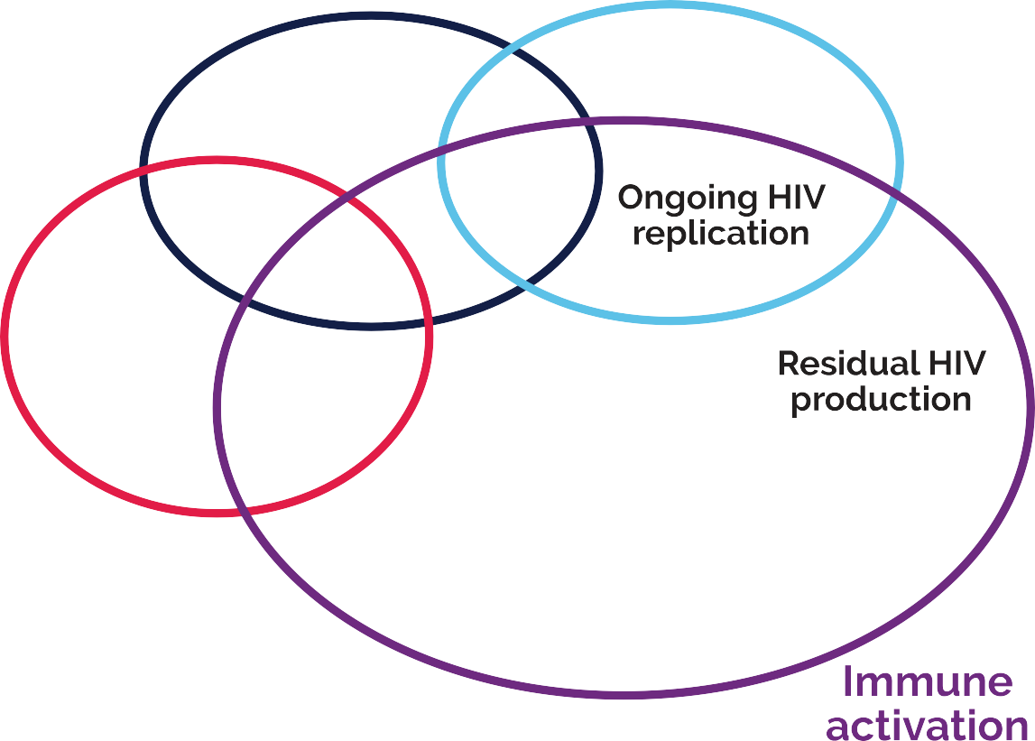
Multiple factors can influence CD4 recovery during treatment³
A low CD4 count can also occur due to:
Treatment Failure
Late diagnosis
Race/gender
ART, antiretroviral therapy; IL, interleukin; TNFα, tumour necrosis factor alpha
3. Corbeau P and Reynes J. Immune reconstitution under antiretroviral therapy: the new challenge in HIV-1 infection. Blood 2011;117:5582–90
7

Slide 8
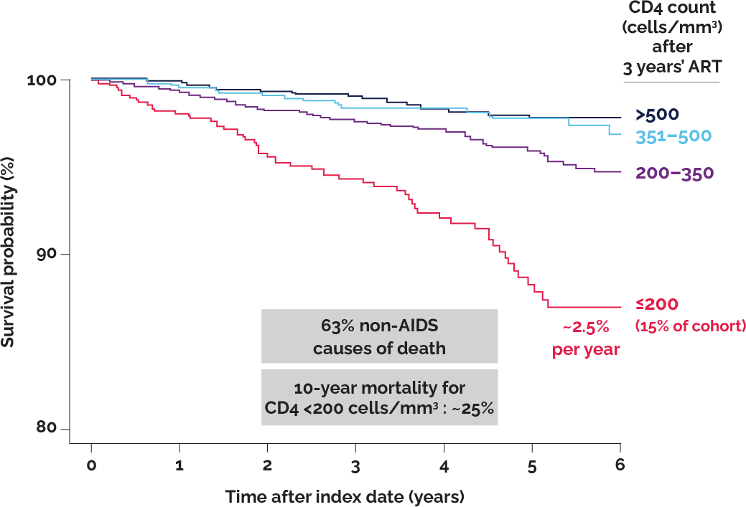
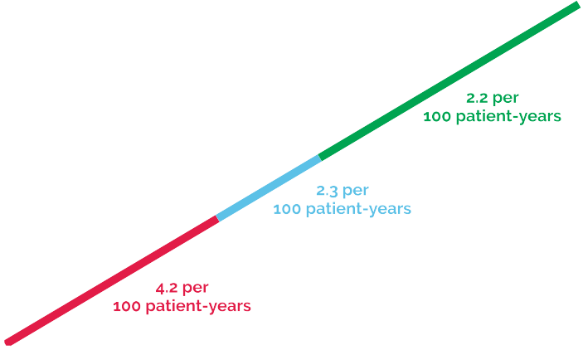
A low CD4 count drives mortality and morbidity
Major complications that can arise with HIV infection⁴
Clinical importance of CD4:CD8 ratio⁵
Mortality even higher in those with poor CD4 recovery during ART⁶
The CD4:CD8 ratio describes overall immune dysfunction and can highlight disease progression, response to treatment, morbidity and mortality for the virologically suppressed
As CD4 count decreases, the risk of opportunistic infections increases as the immune system weakens
Mortality is higher in those with a poor CD4 recovery during suppressive ART
CMV, cytomegalovirus; CNS, central nervous system; HSV, herpes simplex virus; PML, progressive multifocal leukoencephalopathy
4. Infectious Disease Advisor. Fever in the Human Immunodeficiency Virus (HIV) Patient. Available at: www.infectiousdiseaseadvisor.com/home/decision-support-in-medicine/infectious-diseases/fever-in-the-human-immunodeficiency-virus-hivpatient (accessed October 2021); 5. Adapted from: Mussini C et al. CD4/CD8 ratio normalization and non-AIDS-related events in individuals with HIV who achieve viral load suppression with antiretroviral therapy: an observational cohort study. Lancet HIV 2015;2:e98–106; 6. Engsig FN et al. Long-term mortality in HIV-positive individuals virally suppressed for >3 years with incomplete CD4 recovery. Clin Infect Dis 2014;58:1312–21
8

Slide 9
Poor CD4 recovery is associated with increased inflammation
Interleukin 6 (IL-6) plays a key role in the acute phase response and in the transition from acute to chronic inflammation. Dysregulation of IL-6 production is a major contributor to the pathogenesis of HIV chronic inflammation⁸
A strong association between HIV replication and raised D-dimer levels has been demonstrated.
D-dimer levels decline following ART initiation and increase after stopping ART in treatment-experienced patients. D-dimer is a predictive biomarker of overall mortality⁹
The bacterial endotoxin lipopolysaccharide (LPS) and
LPS-related markers such as soluble CD14 (sCD14) quantify microbial translocation in peripheral blood. A leaky gut can cause an inflammatory response that induces innate and acquired immunity¹⁰
A poor CD4 recovery from initiation of ART is associated with increased inflammation⁷
FEU, fibrinogen equivalent units
9
7. Lederman MM et al. Immunologic failure despite suppressive antiretroviral therapy is related to activation and turnover of memory CD4 cells. J Infect Dis 2011;204:1217–26; 8. Borges AH et al. Factors associated with plasma IL-6 levels during HIV infection. J Infect Dis 2015;212:585– 95; 9. Borges AH et al. Factors associated with D-dimer levels in HIV-infected individuals. PLoS One 2014;9:e90978; 10. Bukh AR et al. Endotoxemia is associated with altered innate and adaptive immune responses in untreated HIV-1 infected individuals. PLoS One 2011;6: e21275

Slide 10
Immune non-responders (INR) are those that fail to achieve an increase in CD4 T cells during suppressive treatment
Immune non-response (INR):¹²
Failure to achieve a CD4 count of >350 cells/mm³ after two years of ART despite the virus being undetectable
or
Failure to achieve an increase in CD4 count of >50 cells/mm³ after six months of ART – despite the virus being undetectable
11. Adapted from: i-Base. The natural history of HIV in detail. Available at: https://i-base.info/guides/art-in-pictures/the-natural-history-of-hiv-in-detail. Accessed October 2021; 12. Yang X et al. Incomplete immune reconstitution in HIV/AIDS patients on antiretroviral therapy: challenges of immunological non-responders. J Leukoc Biol. 2020;107:597–612
10

Slide 11
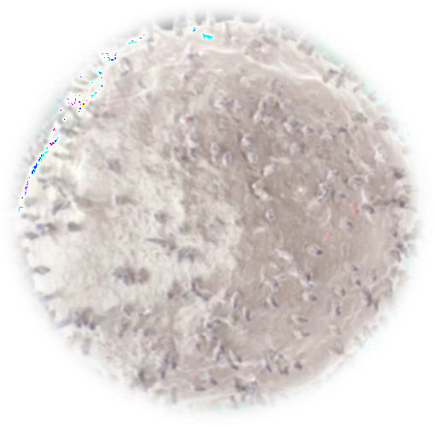
Summary
Importance
of CD4
– CD4 T cells are critical in mounting an effective immune response, as well as being the targets for HIV-1 infection and destruction¹
A low CD4 count can increase the risk of AIDS and non-AIDS events⁴
A comorbidity gap still exists (even with nadir CD4 count <500 cells/mm³)⁶
A low CD4:CD8 ratio is associated with a higher incidence of non-AIDS-defining events⁵
Consequences of low CD4 count
Impact of inflammation in HIV-1
Poor CD4 recovery is associated with increased Inflammation^{7–10}
Inflammation can predict morbidity and mortality^{7–10}
Immune
non-response
(INR)
A low CD4 count at HIV diagnosis can have profound long-term implications^{11,12}
INR leads to a reduced ability to control HIV, other ongoing infections and
regulate immune responses, as well as the key functions of CD4 T cells^{11,12}
1. Appay V, Sauce D and Kelleher AD. HIV Infection as a Model of Accelerated Immunosenescence. In: Fulop T et al (eds). Handbook on Immunosenescence. Cham: Springer Nature AG. 2019. pp. 1961–89. 4. Infectious Disease Advisor. Fever in the Human Immunodeficiency Virus (HIV) Patient. Available at: www.infectiousdiseaseadvisor.com/home/decision-support-in-medicine/infectious- diseases/fever-in-the-human-immunodeficiency-virus-hivpatient (accessed October 2021); 5. Adapted from: Mussini C et al. CD4/CD8 ratio normalization and non-AIDS-related events in individuals with HIV who achieve viral load suppression with antiretroviral therapy: an observational cohort study. Lancet HIV 2015;2:e98–106; 6. Engsig FN et al. Long-term mortality in HIV-positive individuals virally suppressed for >3 years with incomplete CD4 recovery. Clin Infect Dis 2014;58:1312–21. 7. Lederman MM et al. Immunologic failure despite suppressive antiretroviral therapy is related to activation and turnover of memory CD4 cells. J Infect Dis 2011;204:1217–26; 8. Borges AH et al. Factors associated with plasma IL-6 levels during HIV infection. J Infect Dis 2015;212:585–95; 9. Borges AH et al. Factors associated with D-dimer levels in HIV-infected individuals. PLoS One 2014;9:e90978; 10. Bukh AR et al. Endotoxemia is associated with altered innate and adaptive immune responses in untreated HIV-1 infected individuals. PLoS One 2011;6: e21275. 11. Adapted from: i-Base. The natural history of HIV in detail. Available at: https://i-base.info/guides/art-in-pictures/the-natural-history- of-hiv-in-detail. Accessed October 2021; 12. Yang X et al. Incomplete immune reconstitution in HIV/AIDS patients on antiretroviral therapy: challenges of immunological non-responders. J Leukoc Biol. 2020;107:597–612
11

Slide 12
Abbreviations
ART, antiretroviral therapy
CMV, cytomegalovirus
CNS, central nervous system CVD, cardiovascular disease FEU, fibrinogen equivalent units HSV, herpes simplex virus
IL, interleukin
PML, progressive multifocal leukoencephalopathy Th1, T helper type 1
Th2, T helper type 2 Th17, T helper type 17 Tfh, T follicular helper Treg, regulatory T cell
TNFα, tumour necrosis factor alpha
12

Slide 13
Bibliography
Appay V, Sauce D and Kelleher AD. HIV Infection as a Model of Accelerated Immunosenescence. In: Fulop T et al (eds). Handbook on Immunosenescence. Cham: Springer Nature AG. 2019. pp. 1961–89
Marcus JL et al. Comparison of overall and comorbidity-free life expectancy between insured adults with and without HIV infection, 2000–2016.
JAMA Netw Open 2020;3:e207954
Corbeau P and Reynes J. Immune reconstitution under antiretroviral therapy: the new challenge in HIV-1 infection. Blood 2011;117:5582–90
Infectious Disease Advisor. Fever in the Human Immunodeficiency Virus (HIV) Patient. Available at: www.infectiousdiseaseadvisor.com/home/decision-support-in-medicine/infectious-diseases/fever-in-the-human-immunodeficiency-virus- hivpatient (accessed October 2021)
Adapted from: Mussini C et al. CD4/CD8 ratio normalization and non-AIDS-related events in individuals with HIV who achieve viral load
suppression with antiretroviral therapy: an observational cohort study. Lancet HIV 2015;2:e98–106
Engsig FN et al. Long-term mortality in HIV-positive individuals virally suppressed for >3 years with incomplete CD4 recovery. Clin Infect Dis
2014;58:1312–21
Lederman MM et al. Immunologic failure despite suppressive antiretroviral therapy is related to activation and turnover of memory CD4 cells. J Infect Dis 2011;204:1217–26
Borges AH et al. Factors associated with plasma IL-6 levels during HIV infection. J Infect Dis 2015;212:585–95
Borges AH et al. Factors associated with D-dimer levels in HIV-infected individuals. PLoS One 2014;9:e90978
Bukh AR et al. Endotoxemia is associated with altered innate and adaptive immune responses in untreated HIV-1 infected individuals. PLoS One
2011;6: e21275
Adapted from: i-Base. The natural history of HIV in detail. Available at: https://i-base.info/guides/art-in-pictures/the-natural-history-of-hiv-in- detail. Accessed October 2021
12. Yang X et al. Incomplete immune reconstitution in HIV/AIDS patients on antiretroviral therapy: challenges of immunological non-responders. J Leukoc Biol. 2020;107:597–612
13

Slide 14
RUKOBIA prescribing information
Rukobia fostemsavir 600 mg prolonged release tablets
See Summary of Product Characteristics (SmPC) before prescribing
Indications: Adults with multidrug resistant HIV-1 infection (in combination with other antiretroviral medications) for whom it is otherwise not possible to construct a suppressive antiviral regimen.
Dosing: Adults (over 18 years): 600 mg twice daily, with or without food, swallowed whole with water – do not crush, chew or split the tablets. Elderly: No dosage adjustment required. (Limited data in 65+ yrs). No dosage adjustment required in renal or hepatic impairment.
Contraindications: Hypersensitivity to any ingredient. Coadministration with strong CYP3A inducers including, but not limited to: carbamazepine, phenytoin, mitotane, enzalutamide, rifampicin and St John’s Wort.
Special warnings and precautions: See SmPC for full details. Rukobia is not recommended for treatment of infections due to HIV-1 Group M subtype CRF01_AE strains. Risks of immune reconstitution inflammatory syndrome, opportunistic infections, osteonecrosis. Use with caution in patients with a history of QT interval prolongation, when co-administered with a medicine with a known risk of Torsade de Pointes (e.g. amiodarone, disopyramide, ibutilide, procainamide, quinidine, or sotalol) or in patients with relevant pre-existing cardiac disease. Elderly patients may be more susceptible to drug-induced QT interval prolongation. Monitor LFTs in hepatitis B and/or C co-infection. Co-administration with elbasvir/grazoprevir is not recommended. Use with caution when co-administered with statins that are substrates for OATP1B1/3 or BCRP, and consider dose modifications.
Doses of co-administered oestrogen-based therapies should not exceed 30 μg/day of ethinyl oestradiol. Caution is advised particularly in patients with additional risk factors for thromboembolic events. The recommended dose of co-administered tenofovir alafenamide (TAF) is 10mg.
Pregnancy/lactation: Avoid use of Rukobia during pregnancy as data are
limited. Do not breast-feed.
Side effects: See SmPC for full details. Diarrhoea, headache, nausea, rash, abdominal pain, vomiting, immune reconstitution inflammatory syndrome, insomnia, dizziness, somnolence, dysgeusia, QT prolongation, dyspepsia, flatulence, pruritus, myalgia, fatigue, and increases in transaminases, creatinine and CPK.
Trademarks are owned by or licensed to the ViiV Healthcare group of
companies.
SmPC: https://www.ema.europa.eu/en/medicines/human/EPAR/rukobia
Prescribing information for ViiV Healthcare products is available here: https://viivhealthcare.com/en-us/our-medicines/
or via your ViiV Healthcare contact
Adverse events should be reported. For the UK, reporting forms and information can be found at www.mhra.gov.uk/yellowcard or search for MHRA Yellowcard in the Google Play or Apple App store. Adverse events should also be reported to GlaxoSmithKline on 0800 221441.
Link to AE reporting can be accessed in your viewing platform
14

